Slide 1
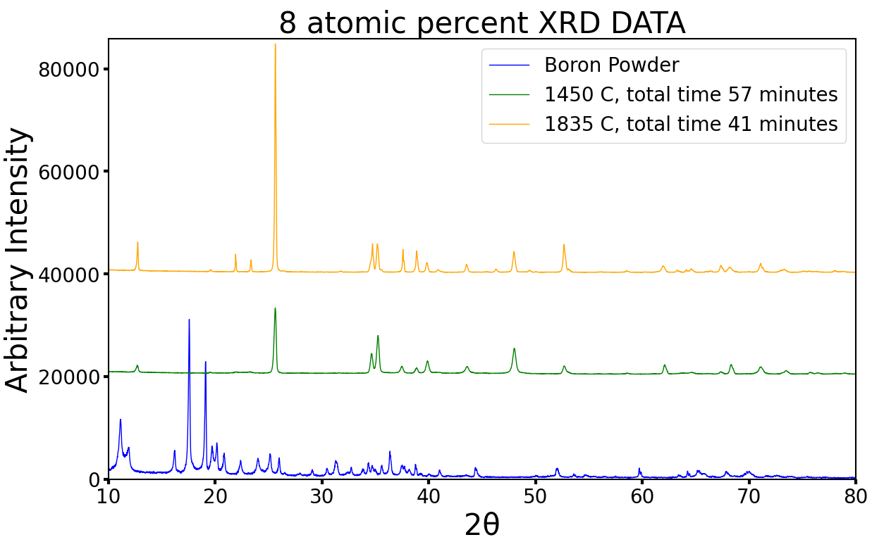
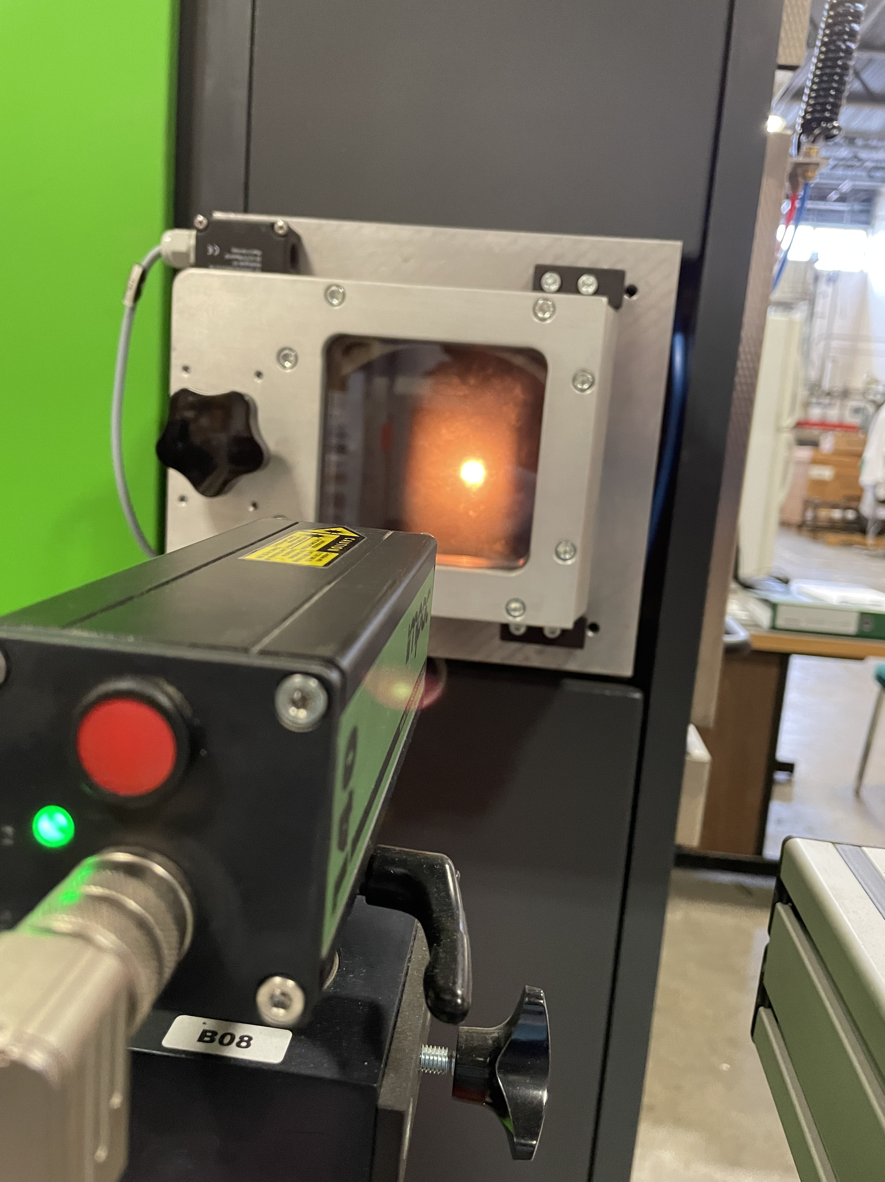
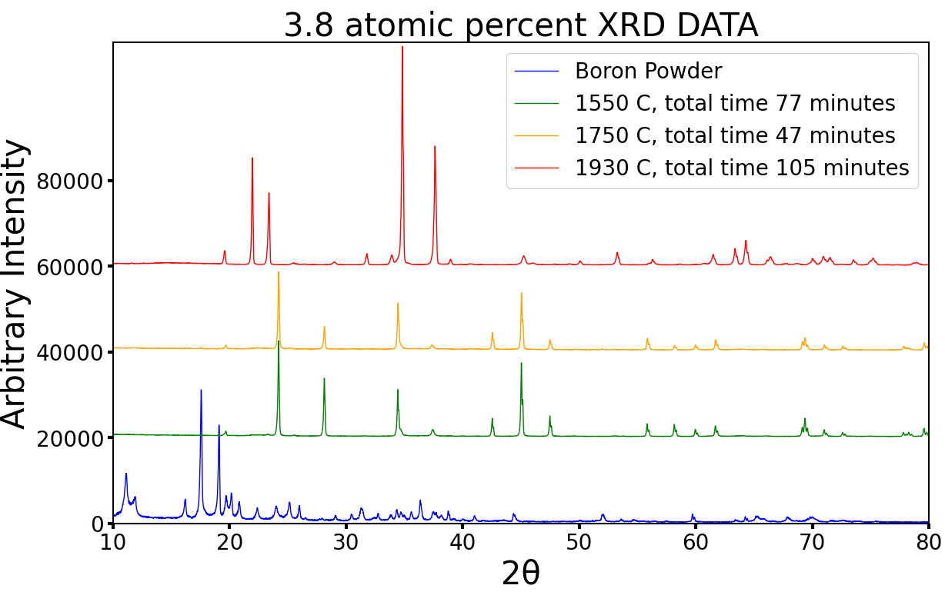
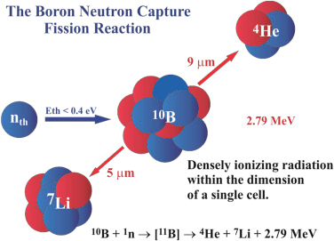
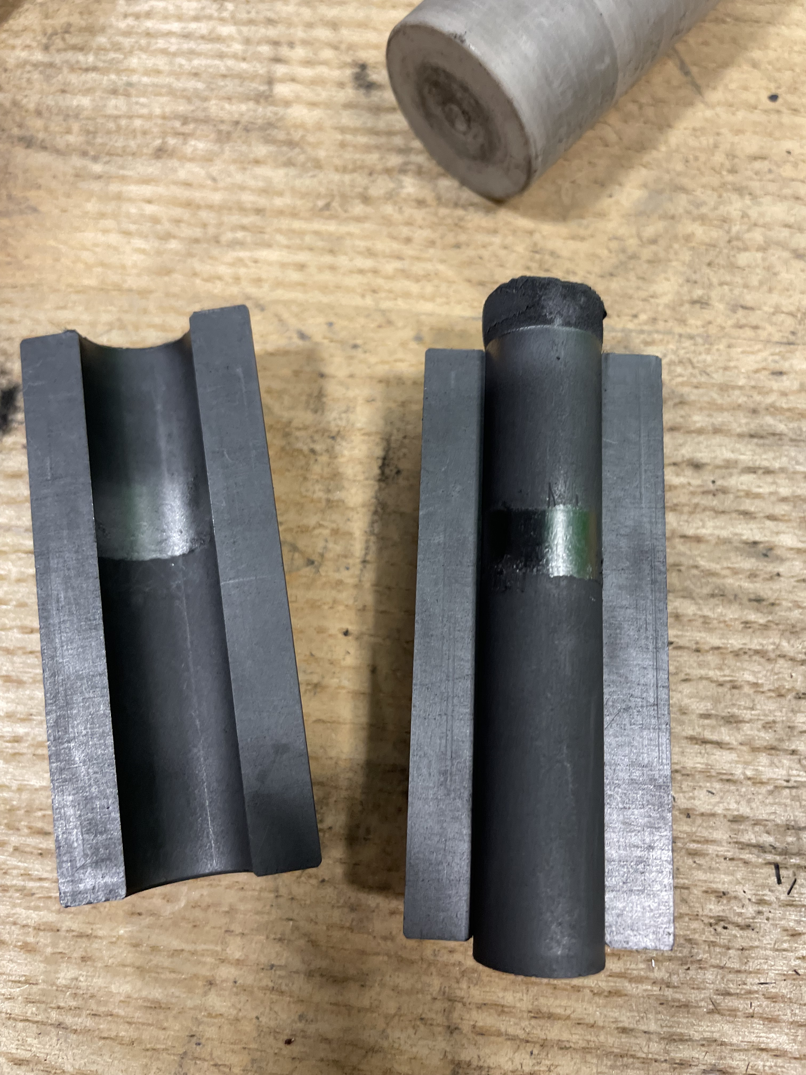
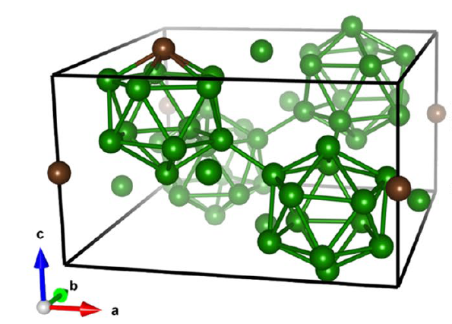
Synthesis of boron-rich boron-carbon compounds
Wesley Sutton, Seth Iwan, and Yogesh K. Vohra
Abstract
Methods
Results
Boron-carbon compounds have been shown to be a potential avenue for lightweight, high hardness materials with a myriad of unique mechanical and electronic properties that make it a candidate in the abrasive, nuclear shielding, and many other industries. Boron powder, with purity 99.99%, was mixed with Carbon in a SPEX SamplePrep 8000M High-Energy Ball Mill. Spark plasma sintering was utilized to synthesize and sinter the boron carbon compounds. Two types of novel boron-carbon compounds, 3.8 and 8 atomic percent Carbon, were synthesized and characterized. Synthesis was done at a pressure of 7 megapascals and at various temperatures ranging from 1500C-1850C. The crystalline structure of the precursor powder and the post synthesis samples was examined via X-ray Diffraction to determine information about the phases synthesized and the effects of temperature and heating time on the high-pressure high-temperature synthesis process.
BALL MILLING
For both samples, boron powder (99.99% purity) and graphite powder (99.9995% purity) were mixed to make 3.8 and 8 at% carbon mixtures. The powders were loaded into a tungsten carbide canister with two tungsten carbide balls and 15ml of acetone and shaken in a SPEX 8000M high-energy ball mill. This allows the powders to be thoroughly mixed and ground down to the smallest grains possible in preparation for sintering.
Figure 7: XRD data for the 8 atomic percent carbon samples
SPARK PLASMA SINTERING
The powder, once made, was synthesized via spark plasma sintering in a DR. FRITSCH DSP 507. A five-part die system was used consisting of an outer cylindrical mold and an interior cylindrical mold in two pieces, and a top and bottom punch. The bottom, sides, and top of the interior of the mold were first covered in a layer of molybdenum sheet and then with a graphite sheet. The molybdenum sheet was used to prevent contaminating the sample with graphite, and the graphite sheet was used to ease the removal of the molybdenum and sample after sintering was completed. Once the sample was loaded the system was sealed, evacuated, and inert N gas(95% N, 5% H) was pumped into the system at a rate of 20 liters per minute. The sample is then heated to temperature. Once at temperature, the sample is left for a specified hold time before being rapidly cooled.
Figure 8: XRD data for the 3.8 atomic percent carbon samples
Conclusions and Future Studies
Figure 4: Viewing window of SPS system while at 1500 °C
Our studies shows that novel boron-rich boron-carbide materials can be synthesized by ball milling precursors of boron and graphite powders followed by high-pressure high-temperatures synthesis.
The synthesized bulk materials is different from the thin film B50C2 material synthesized by chemical vapor deposition.
Future work will include identifying the phases created as a function of synthesis conditions and studying the mechanical and thermal oxidation resistance of these novel B-C materials for applications in high-temperature environments.
Figure 1: Boron’s neutron absorption reaction [5]
POLISHING AND XRD
Once the sample was fully cooled and removed from the mold, the outer layers of molybdenum and graphite had to be removed. The molybdenum sheet would have to be removed from the sample via polishing.
Once polished, the samples were studied via x-ray diffraction. The original boron powder was also studied to for comparison with the synthesized B-C material.
Introduction
Boron has been, for the better part of the last century, a forefront in explorations for crystallography. In 1943, Laubengayer et al. [1] asserted they had synthesized a tetragonal crystalline form of Boron with unit cell comprised of 4 boron icosahedra and 2 interstitial atoms, for a total of 50 boron atoms. It was later shown on theoretical grounds this structure would be unstable[2]. Additional analysis from Will et al. showed that the more likely structure was instead B₅₀C₂ [3]. Later theoretical predictions have further shown that B50C2 is a stable crystal structure, and the creation of thin film B50C2 has been performed via chemical vapor deposition [4]. In this study, we hypothesized that B50C2 or similar theorized novel boron-carbon phases could be formed in bulk via spark plasma sintering.
References
¹A. W. Laubengayer, D. T. Hurd, A. E. Newkirk, and J. L. Hoard, “Boron. i. preparation and properties of pure crystalline boron”, Journal of the American Chemical Society 65, 1924–1931 (1943).
²H. C. Longuet-Higgins and M. de V. Roberts, “The electronic structure of an icosahedron of boron atoms”, Proceedings of the Royal Society of London. Series A, Mathematical and Physical Sciences 230, 110–119 (1955).
³G. Will and K. Kossobutzki, “X-ray diffraction analysis of B50C2 and B50N2 crystallizing in the ”tetragonal” boron lattice”, Journal of the Less-Common Metals 47, 33–38 (1976).
⁴P. A. Baker, W.-C. Chen, C.-C. Chen, S. A. Catledge, and Y. K. Vohra, “First-principles predictions and synthesis of b50c2 by chemical vapor deposition”, Scientific Reports 10, 10.1038/s41598-020-61462-9 (2020).
⁵M. F. L’Annunziata, “Chapter 1 - radioactivity and our well-being”, in Ra-
dioactivity (second edition), edited by M. F. L’Annunziata, Second Edition
(Elsevier, Boston, 2016), pp. 1–66.3
20 mm
Figure 5: Sample after SPS. The punches above and below the sample are compressed during the SPS process while the cylindrical mold keeps the punches in place.
Figure 6: Sample mid-polishing. Silver-colored streaks are from molybdenum to still be removed
Acknowledgements
Support provided by National Science Foundation (Grant # DMR-2148897) – Research Experiences for Undergraduates (REU) awarded to UAB
Figure 2: Theoretical crystal structure of B₅₀C₂ from Baker et al. [4]

