Slide 1
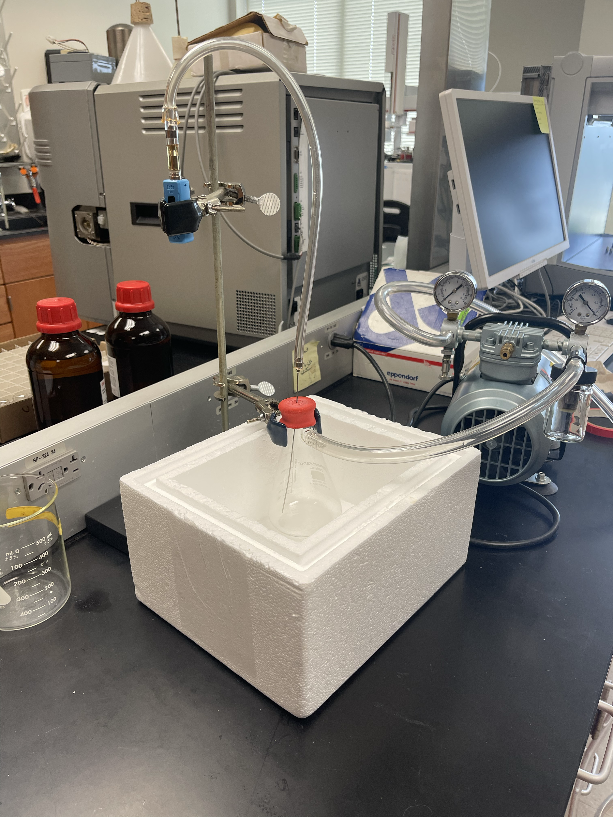
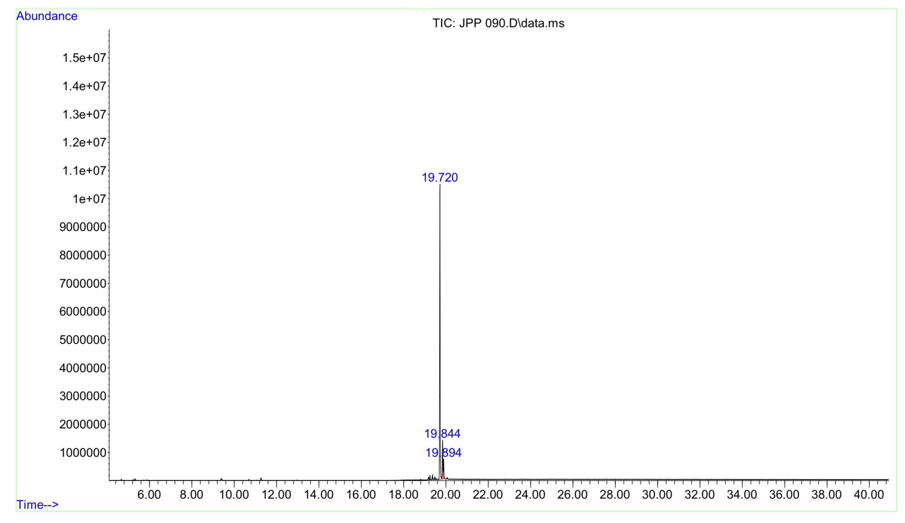
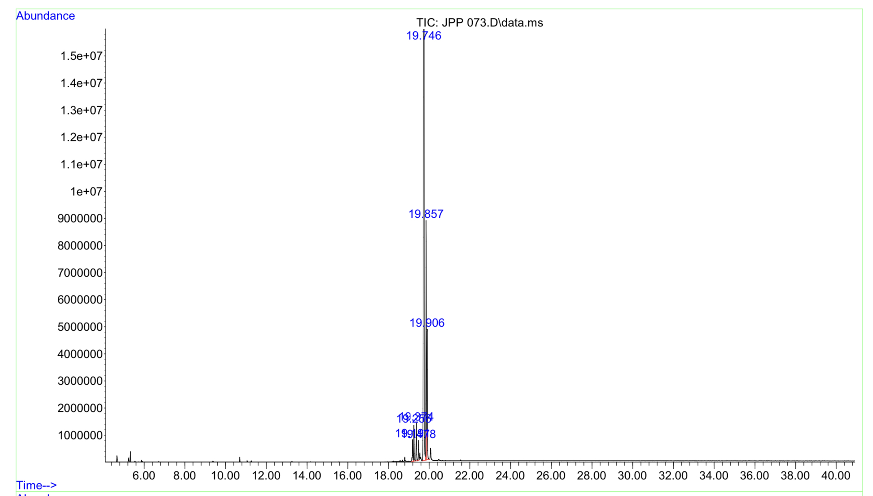
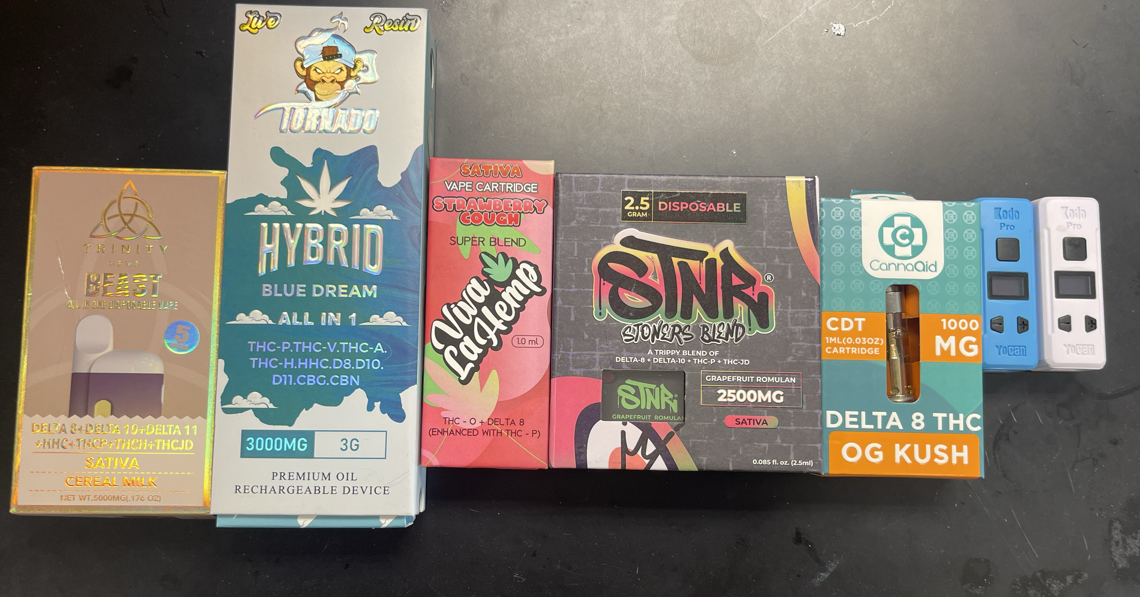
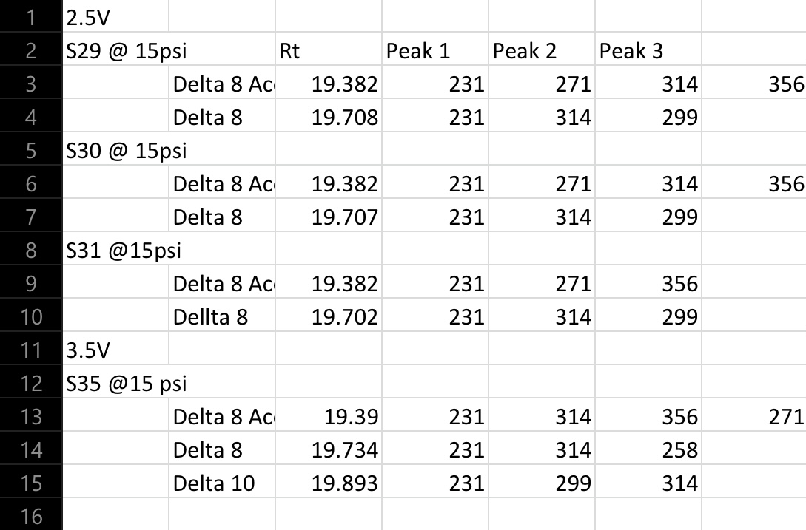
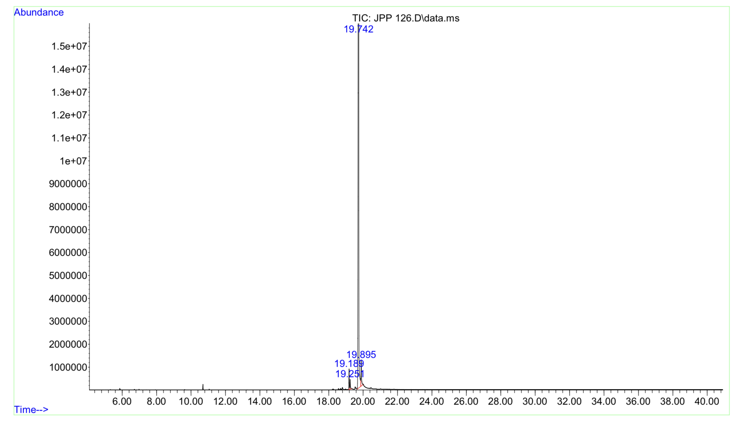
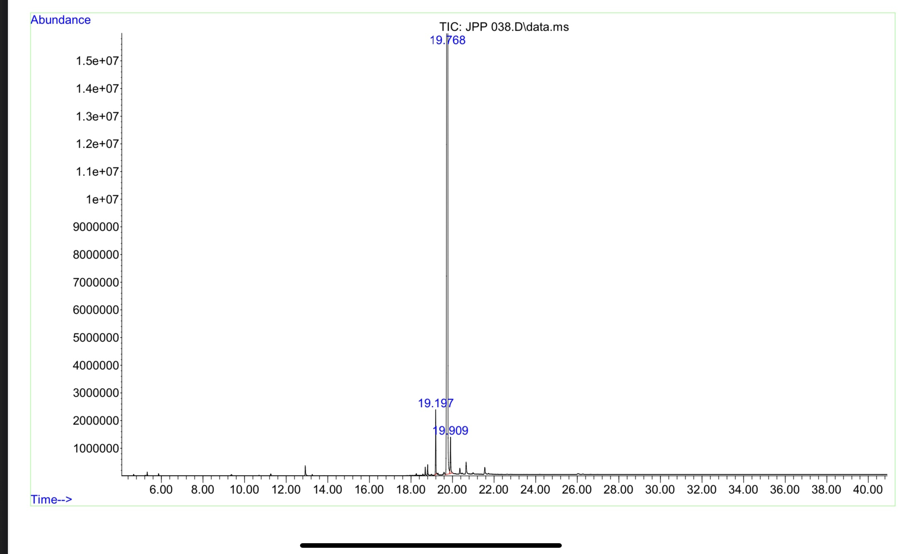
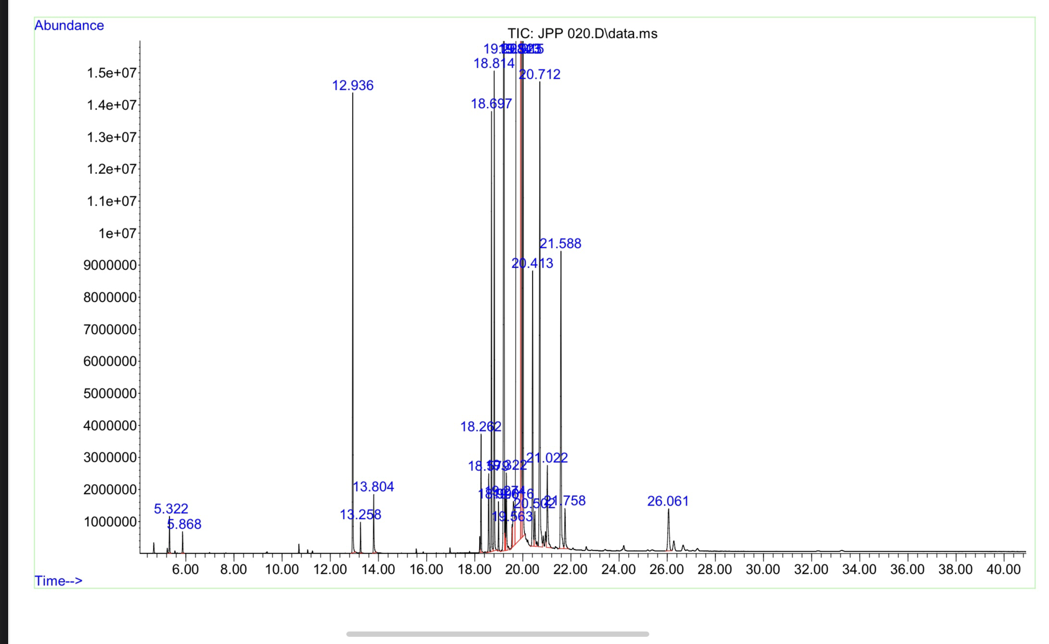
Identification of Hemp-Derived Cannabinoids in E-Liquids
Jada Paige¹, Elizabeth A. Gardner²
¹School of Arts and Sciences, The University of Alabama- Tuscaloosa, AL,
²Criminal Justice Department, University of Alabama at Birmingham- Birmingham, AL
Abstract
Hemp derived from the Cannabis Sativa plant in 2018 was legalized in the Hemp Farming Act of 2018, legalizing hemp that has a Δ⁹- THC maximum concentration of 0.3%.
The objective was to determine if the cannabinoids in vape pens actually contain what is on the label.
The GC-MS was used to separate the complex oils from the vape cartridges, and used to identify and analyze the unknown peaks
Five vapes were analyzed using the GC-MS. Through these vapes ten cannabinoids, 3 terpenes were identified
It was discovered that the vape oil liquid detected more cannabinoids that the vape oil vapors
Methodology
Conclusion
In conclusion when the vapes are actually in use you are not getting everything that is on the label. It depends on concentration of the cannabinoids and the voltage of the battery. The higher the voltage the more cannabinoids you are receiving.
Sample Preparations
Vape oil liquid was put into a tube and 2 mg of methanol was added to dilute oil. 1 mg was added to GC-MS vial.
2 mg of methanol was added to the frozen vapors in the buchner flask then the 2 mg mixture of the vapors and methanol was added to a GC-MS vial
Vaping Conditions
Cartridges were sampled at 1-15 psi and 2- 4.2V.
For cartridges activated by vacuum, the pump was turned on for 2 seconds, a 15 second hold, then turned on again for 2 seconds
For cartridges activated by activation button, the button was pressed for 2 seconds, a 15 second hold, then pressed again for 2 seconds
This was repeated for 2 minutes
This created 10 pulls in the 2-minute interval.
Results and Discussion
Introduction
Δ⁹- THC is the main cannabinoid in Cannabis Sativa with its psychoactive properties to give the “high” feeling.
Δ⁸- THC is an isomer of Δ⁹- THC with the only difference being a double bond at carbon 8 unlike Δ⁹- THC which has the double bond on carbon 9. Δ⁸- THC does not occur naturally, it is manufactured through a chemical extraction from hemp- derived CBD.
CBD is a naturally occurring isomer of Δ⁹- THC. It is non psychoactive and only has two rings unlike Δ⁹- THC which has 3 rings.
Terpenes are a chemical compound that is responsible for the taste and smell in cannabinoids
Vapes can be used to consume nicotine, cannabis, or other substances. The parts of the vape are the cartridge, coil, sensor or power button, and battery
The SB vape was labeled to have Δ⁸ , Δ¹⁰ , THC P, and THC JD. When the vape oil liquid was tested the GC-MS showed around 30 peaks. A dilution was done and three main peaks were discovered. These peaks are the cannabinoids Δ⁸, Δ¹⁰
When the vape oil vapors were tested only one peak was seen on the GC-MS. That peak was Δ⁸
The reason that you only get one peak when the vapor are tested opposed to the liquid is because there are not the same cannabinoids listed on the label than what is actually in the vape or Δ⁸is the cannabinoid of highest concentration so it is the most prominent in testing
The Viva vape was labeled to have THC O, Δ⁸, and THC P. When the vapor oil liquid was tested 5 main peaks were identified.
When the vapors were tested 3 peaks representing 3 different cannabinoids. They were identified as Δ⁸, Δ⁸ acetate, and Δ¹⁰
The reason for not getting the same cannabinoids except for Δ⁸ could be because they do not actually have THC O and THC P or because THC O is a newly discovered cannabinoid and there are not many studies on the cannabinoid
The Dream Vape is said to have to THC P, THC V, THC A, THC H, CBG, CBN, Hexahydrocannabinol (HHC), Δ⁸, Δ¹⁰, and Δ¹¹. The vape oil liquid had 6 peaks identified. They were the R and S isomer of HHC, Δ⁸, the R and S isomer of Δ¹⁰, and the 9S isomer of Δ¹⁰
When the vape oil vapors were tested only 3 peaks appeared and they were identified as Δ⁸, and Δ¹⁰
Acknowledgements
Support provided by National Science Foundation (Grant # DMR-2148897 – Research Experiences for Undergraduates (REU) awarded to UAB

