Slide 1
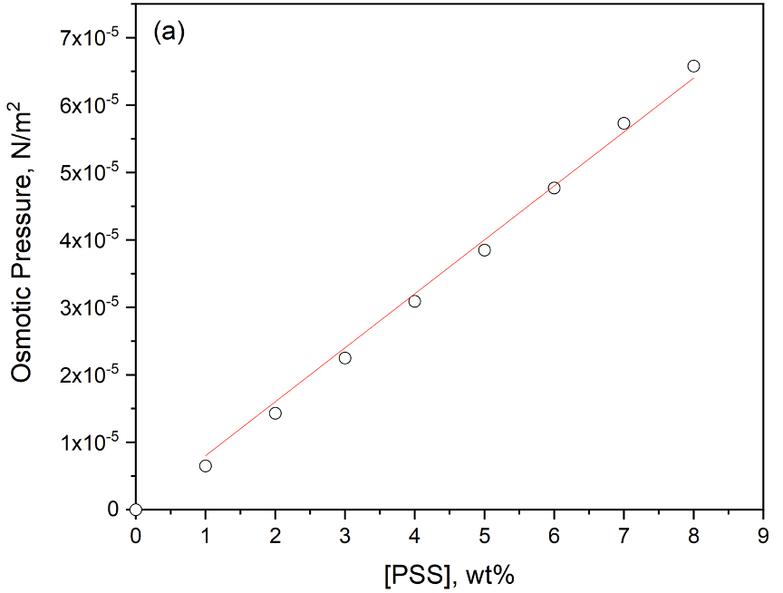
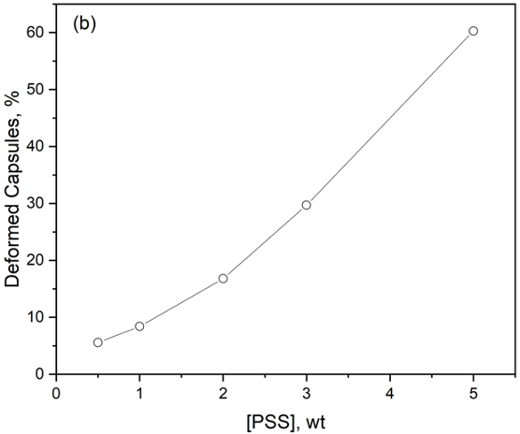
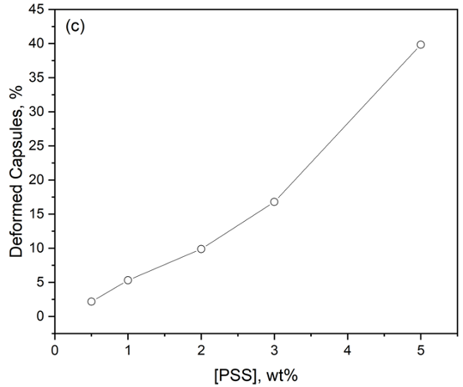
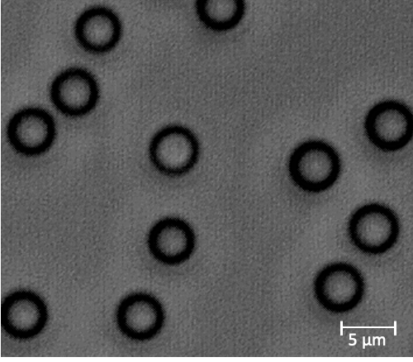
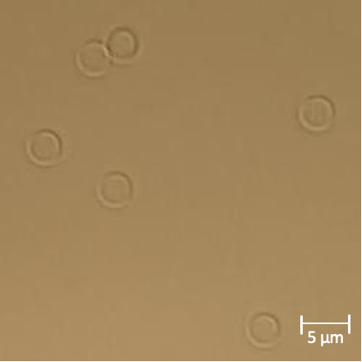
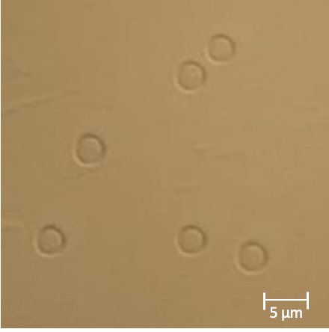
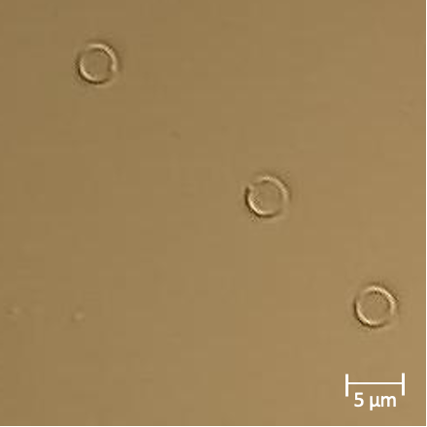
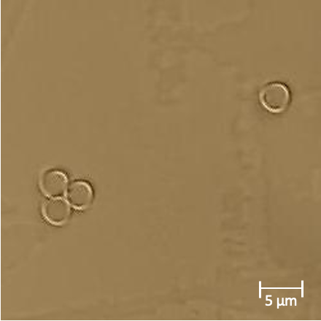
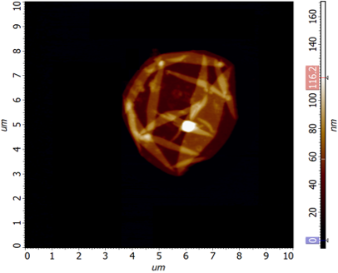
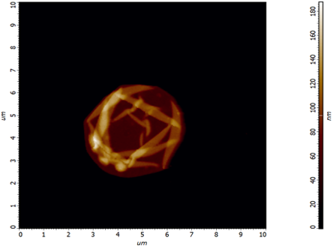
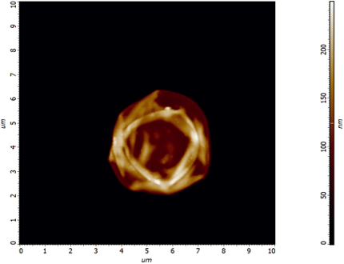
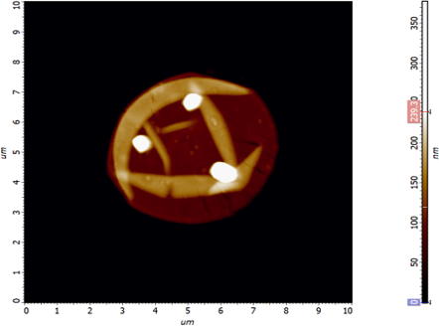
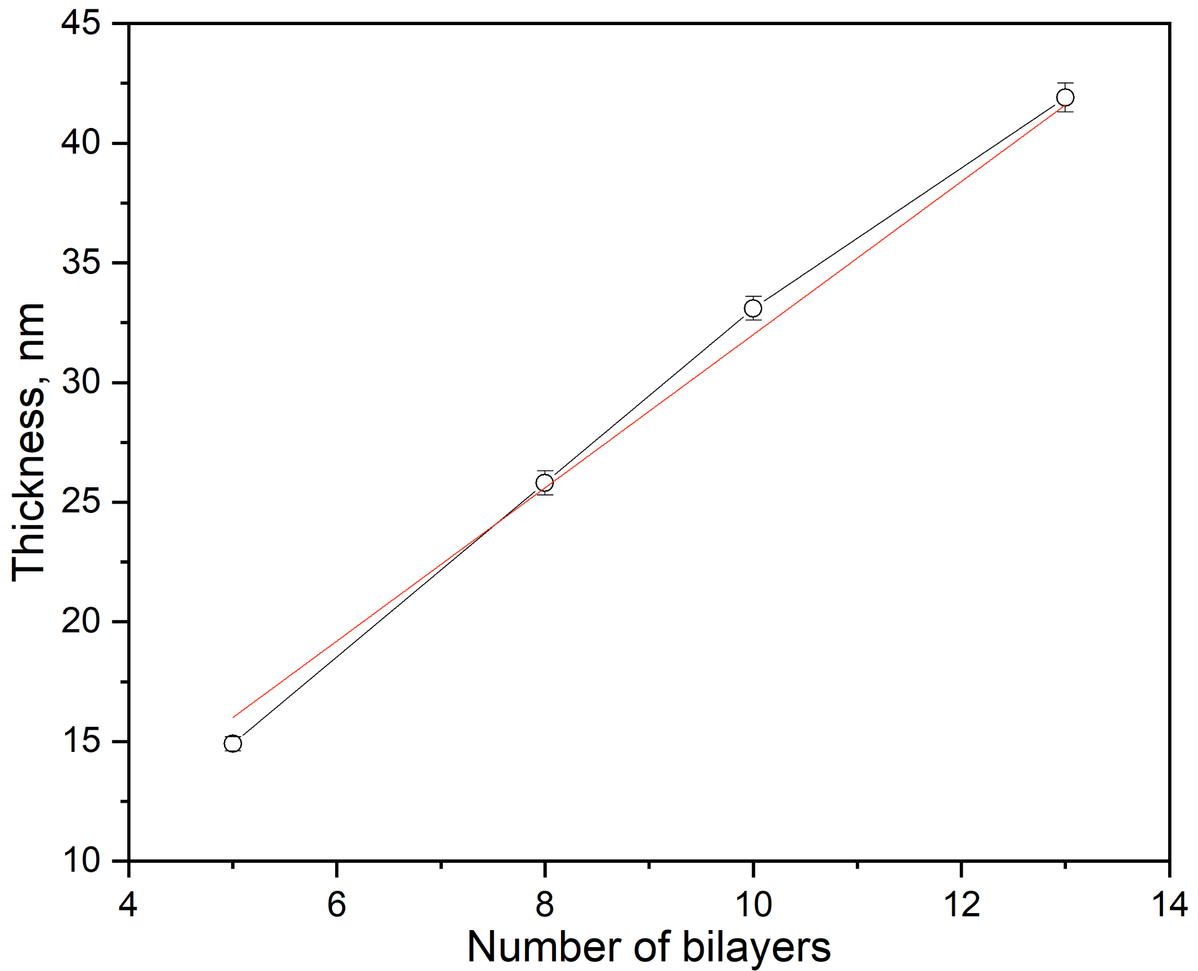
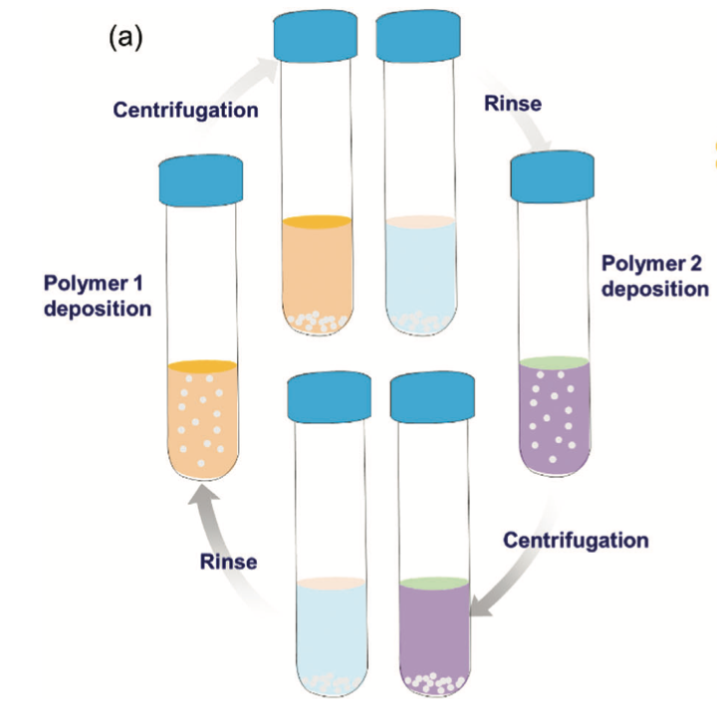
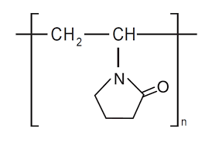
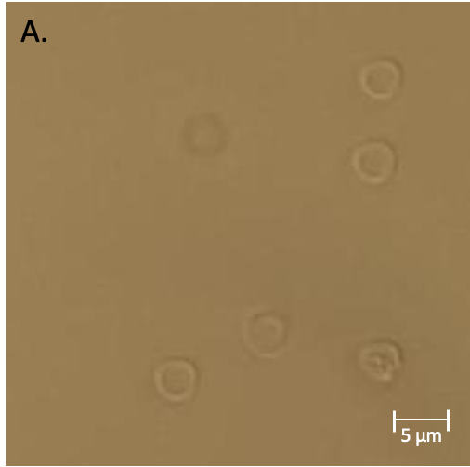
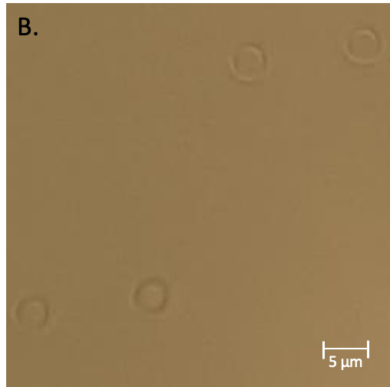
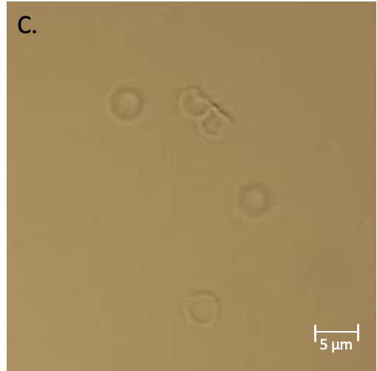
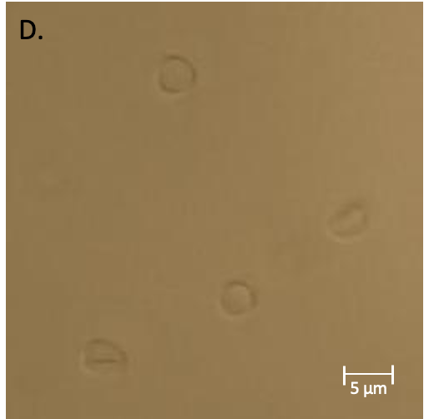
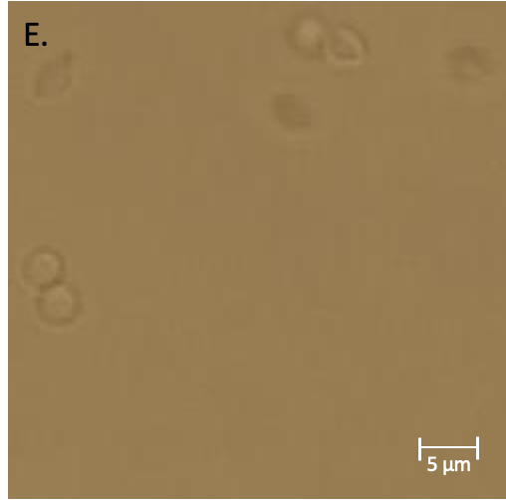
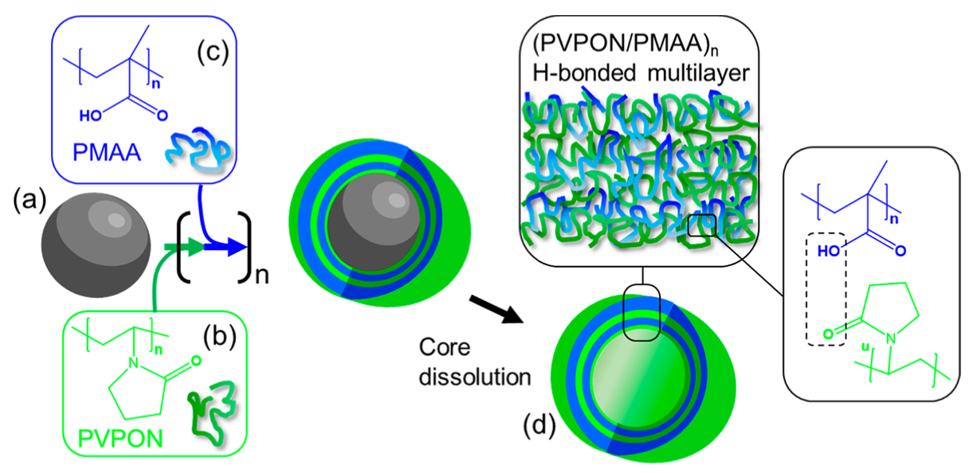
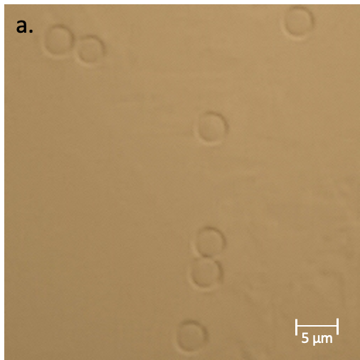
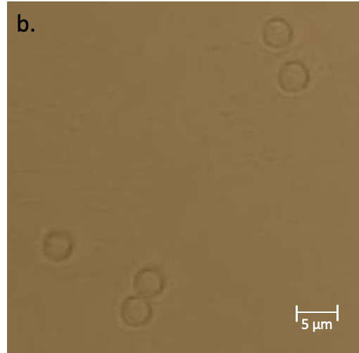
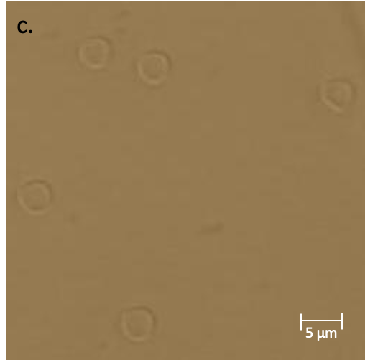
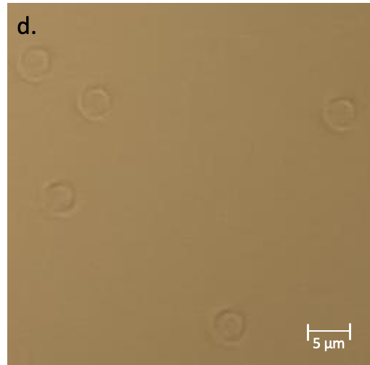
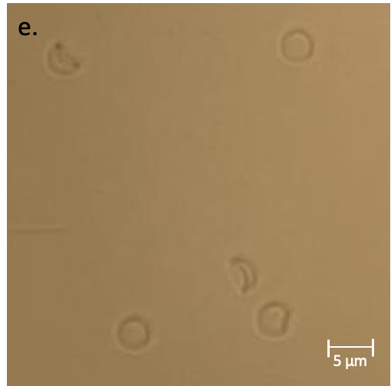
Mechanical Deformation of Hydrogen-Bonded Multilayer Capsules Assembled from Poly(methacrylic Acid-co-(aminopropyl)-methacrylamide) and Poly(N-vinylpyrrolidone)
Taylor Brown^{1,2} , Olga Khaybullina¹, Veronika Kozlovskaya¹, Eugenia Kharlampieva¹
¹Department of Chemistry, University of Alabama Birmingham, Birmingham, AL
²Department of Chemistry and Forensic Science, Savannah State University, Savannah, GA
Introduction
Results and Discussion
Background
PMAA-NH₂ Synthesis
We report preliminary data of the physicochemical properties and stability of hollow spherical particles for future reference of data with varying capsule shapes.
Previous research demonstrated mechanical flexibility of polymeric carriers with various shapes.⁴
Spherical capsule synthesis using layer-by-layer (LbL) assembly of (PMAA-NH₂/PVPON)_{n} with silica microsphere templates will be discussed.²
PMAA-NH₂ – poly(methacrylic acid-co-(aminopropyl) methacrylamide) copolymer
PVPON – (poly(N-vinylpyrrolidone)
Scheme 1. PMAA-NH₂ synthesis. (a) free radical copolymerization of tert-butyl methacrylate; (b) tert-butoxycarbonyl protective groups removal.⁴
Figure 6. (a) Osmotic Pressure Difference Calibration Curve. Then, the percentages of deformed capsules, as a function of PSS concentration, were measured at pH 4 (b) in presence of PSS and (c) after PSS removal.
Direct dependence between PSS concentration and percentage of buckled capsules was shown.
The composition of PMAA-NH₂ was proven by proton nuclear magnetic resonance spectroscopy. The molecular weight before deprotection were determined by GPC in THF (60,000 g mol⁻¹).
Optical Microscope Images
Conclusions
The synthesis of (PVPON/PMAA-NH₂)_{n} spherical hollow particles via layer-by-layer assembly in aqueous HEPES buffer solution using 4 μm nonporous silica microparticles as sacrificial templates was reported.
Multilayer polymeric capsules can be applied to in vivo targeted drug delivery due to their beneficial mechanical properties and stability.
LbL assembly approach provides capsule shape and wall thickness control.
Capsules synthesized using PMAA-NH₂ copolymer displayed better stability under osmotic pressure compared to PMAA homopolymeric capsules.
As the PSS concentration increased, the amount of buckled capsules increased and the amount of recovered capsules decreased.
These results open up new prospects for development of polymeric carriers with cellular uptake and targeted drug delivery. We will continue exploring the behavior of capsules using more complex shapes against large osmotic pressure deformations.
Goal: investigate the dependence between pressure-induced shape transformations and physical properties of spherical hydrogen-bonded capsules.
A
B
C
D
E
Figure 2. Optical microscope images of sacrificial silica templates before polymer deposition (A) and hydrogen-bonded capsules produced with different number of bilayers: (B) 5, (C) 8, (D) 10, (E) 13.
Aims: fabricate hollow multilayer polymeric particles of different bilayer (BL) amounts and to explore the mechanical properties depending on the capsule wall thickness using the osmotic pressure difference method.
After core dissolution, capsule frames keep the shape of the anisotropic template despite the ultrathin capsule wall (< 50 nm) compared to the particle size, which is one of the main advantages of the approach.
Atomic Force Microscope (AFM) Images
Drug Delivery Systems (DDS)
DDS are devices that enable a drug to travel into or throughout the body.¹ Targeted DDS has an overall goal of delivering therapeutic substances to a specific area, while non-targeted delivers the drugs in the system with no aim.⁵ Our research strives to enhance focused area delivery systems to broaden the category of less harmful treatment methods in the medical field.
A
B
C
D
Figure 3. AFM images of dried hydrogen bonded capsules at A) 5, B) 8, C) 10, and D) 13 bilayers.
Using AFM, the wall thickness and capsule surface topography were collected. The single wall thickness of 5 BL is 14.9 ± 0.3 nm, 8 BL – 25.8 ± 0.5 nm, 10 BL – 33.1 ± 0.5 nm, 13 BL – 41.9 ± 0.6 nm. Figure 4 shows the linear increasing trend of the single capsule wall thickness as the number of bilayers increased. Also, as the wall thickness increased, the stiffness and rigidity increase as well.
References
Layer-By-Layer Assembly
Drug delivery system. Drug Delivery System - an overview | ScienceDirect Topics. (n.d.). https://www.sciencedirect.com/topics/nursing-and-health-professions/drug-delivery-system
Gupta, N., Kozlovskaya, V., Dolmat, M., & Kharlampieva, E. (2019, July 29). Shape Recovery of Spherical Hydrogen-Bonded Multilayer Capsules after Osmotically Induced Deformation. ACS Publications. https://pubs.acs.org/doi/10.1021/acs.langmuir.9b01795
Kozlovskaya, V., & Kharlampieva, E. (2021, October 13). Review of Anisotropic particles through multilayer assembly. Macromolecules Bioscience, 22(1). Retrieved from https://onlinelibrary.wiley.com/doi/10.1002/mabi.202100328.
Kozlovskaya, V., Xue, B., Dolmat, M., & Kharlampieva, E. (2021). Complete PH-dependent shape recovery in cubical hydrogel capsules after large osmotic deformations. Macromolecules, 54(20), 9712–9723. https://doi.org/10.1021/acs.macromol.1c00650
U.S. Department of Health and Human Services. (2022, July). Drug Delivery Systems. National Institute of Biomedical Imaging and Bioengineering. https://www.nibib.nih.gov/science-education/science-topics/drug-delivery-systems-getting-drugs-their-targets-controlled-manner
A
B
Osmotic Pressure Difference Method
Acknowledgements
Thank you to the UAB Physics REU for acceptance into the program and the opportunity to assist in research during the 2023 Summer.
Thank you to Olga Khaybullina and the Kharlampieva Research group for mentorship and experience.
“Support provided by National Science Foundation (Grant # DMR-2148897 – Research Experiences for Undergraduates (REU) awarded to UAB”
C
Figure 1. Main principle of LbL approach. A) Layer-by-Layer submersion process.³ B) PVPON (top) and PMAA-NH₂ copolymer (bottom) structures.⁴ C) Assembly of Hydrogen Bonded Capsules.²
Figure 4. Optical microscope images of capsules after polystyrene sulfonate sodium salt (PSS) treatment (top, capital letters) and after recovery (bottom, lowercase letters) at: A. 0.5%, B. 1%, C. 2%, D. 3%, and E. 5% PSS concentration.

