Slide 1
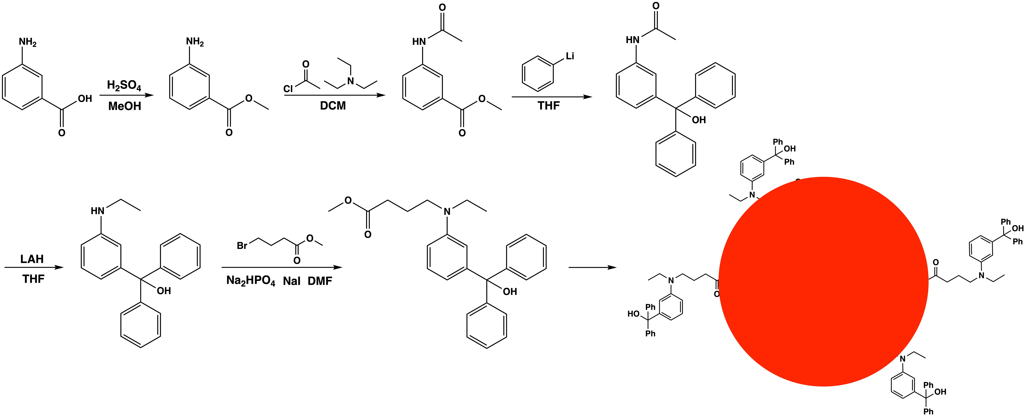
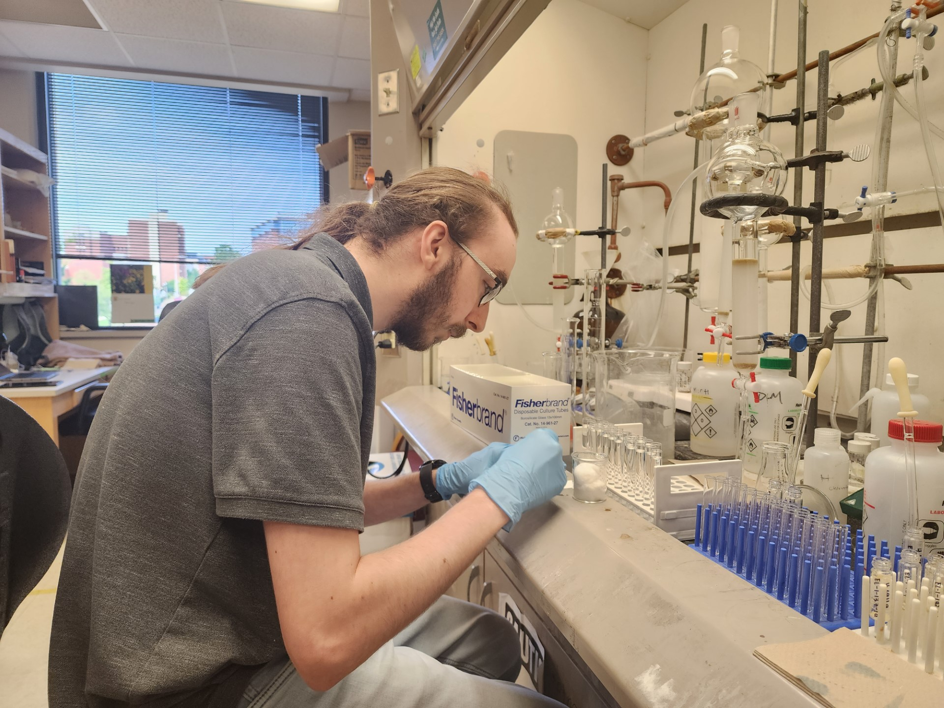
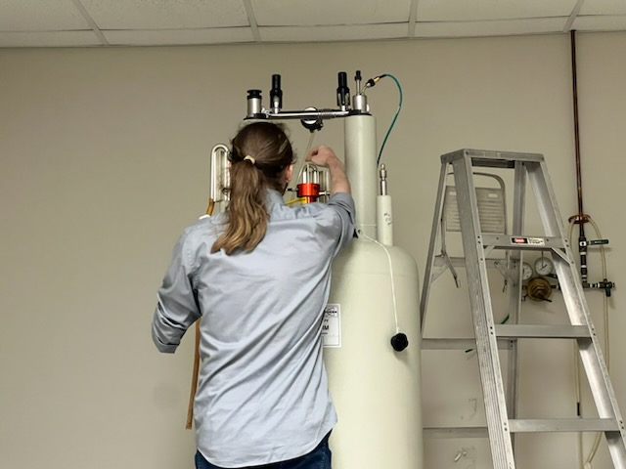
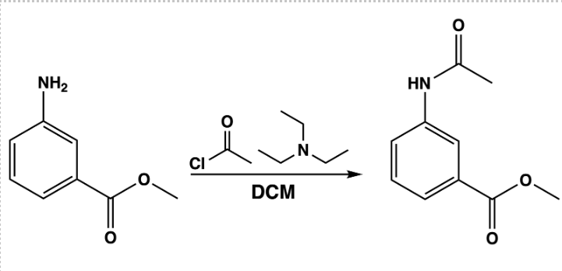
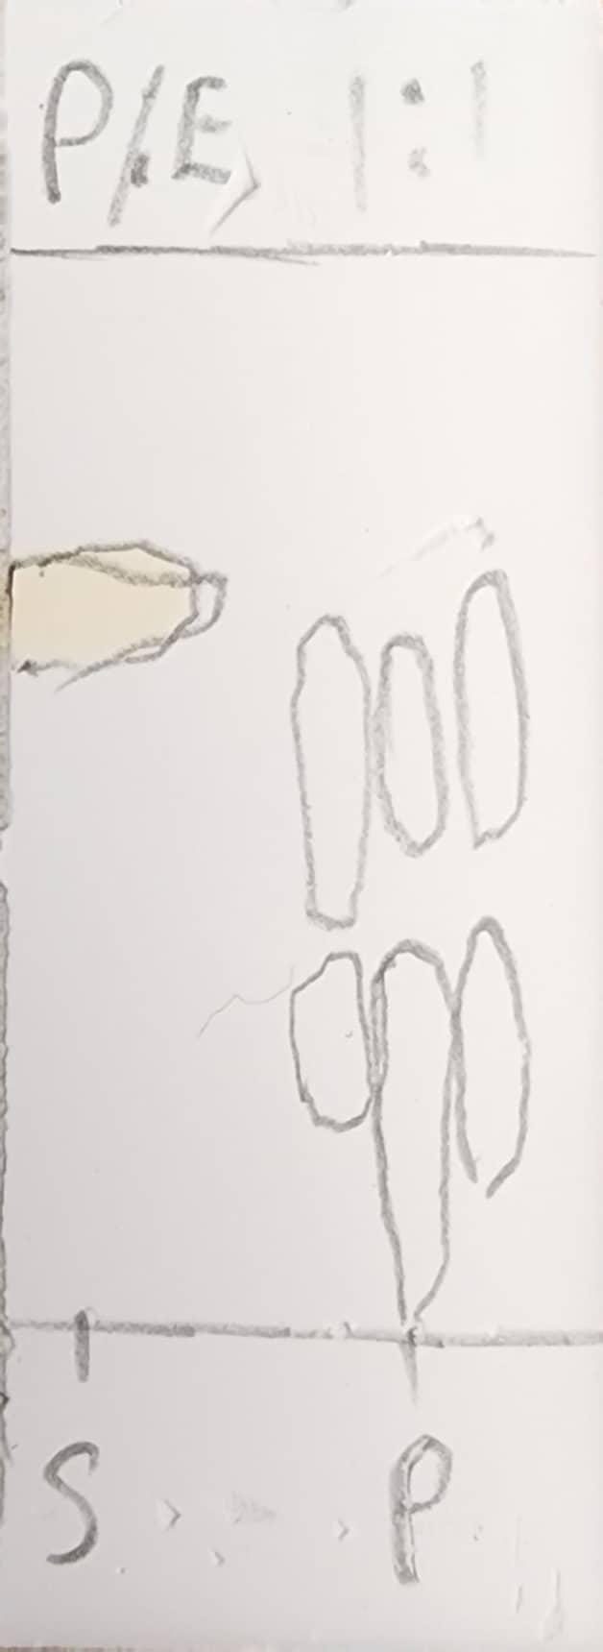
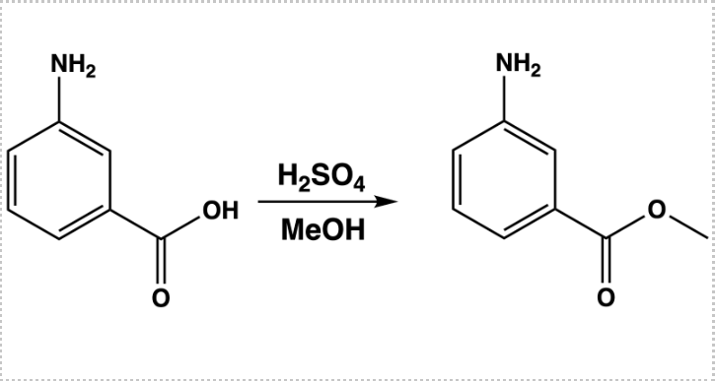
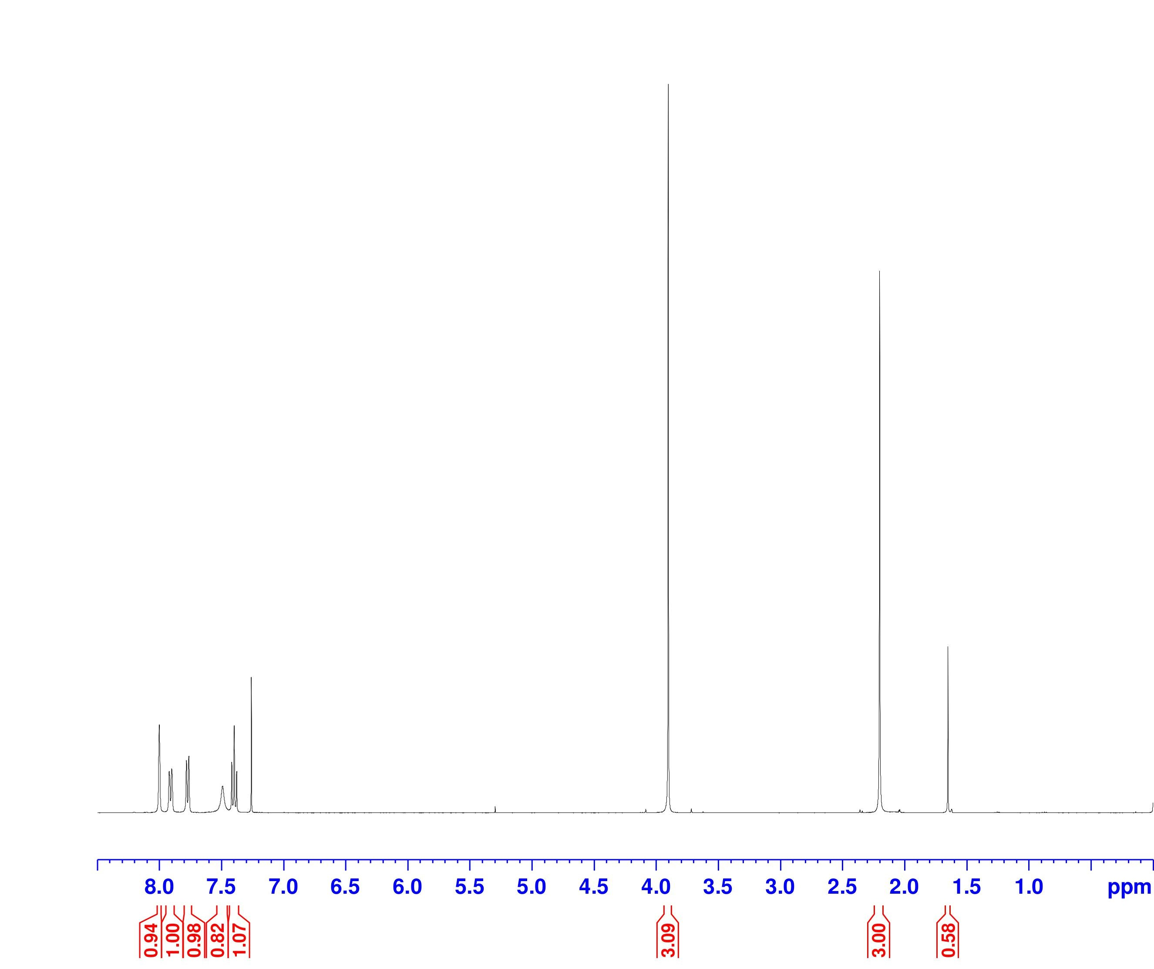
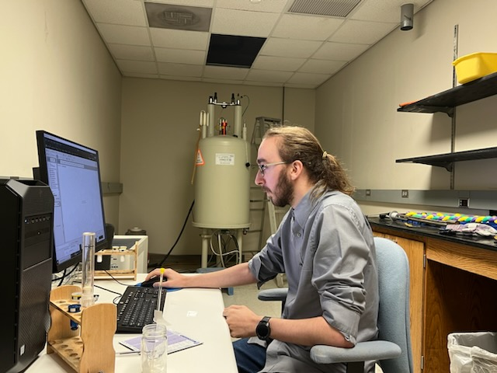
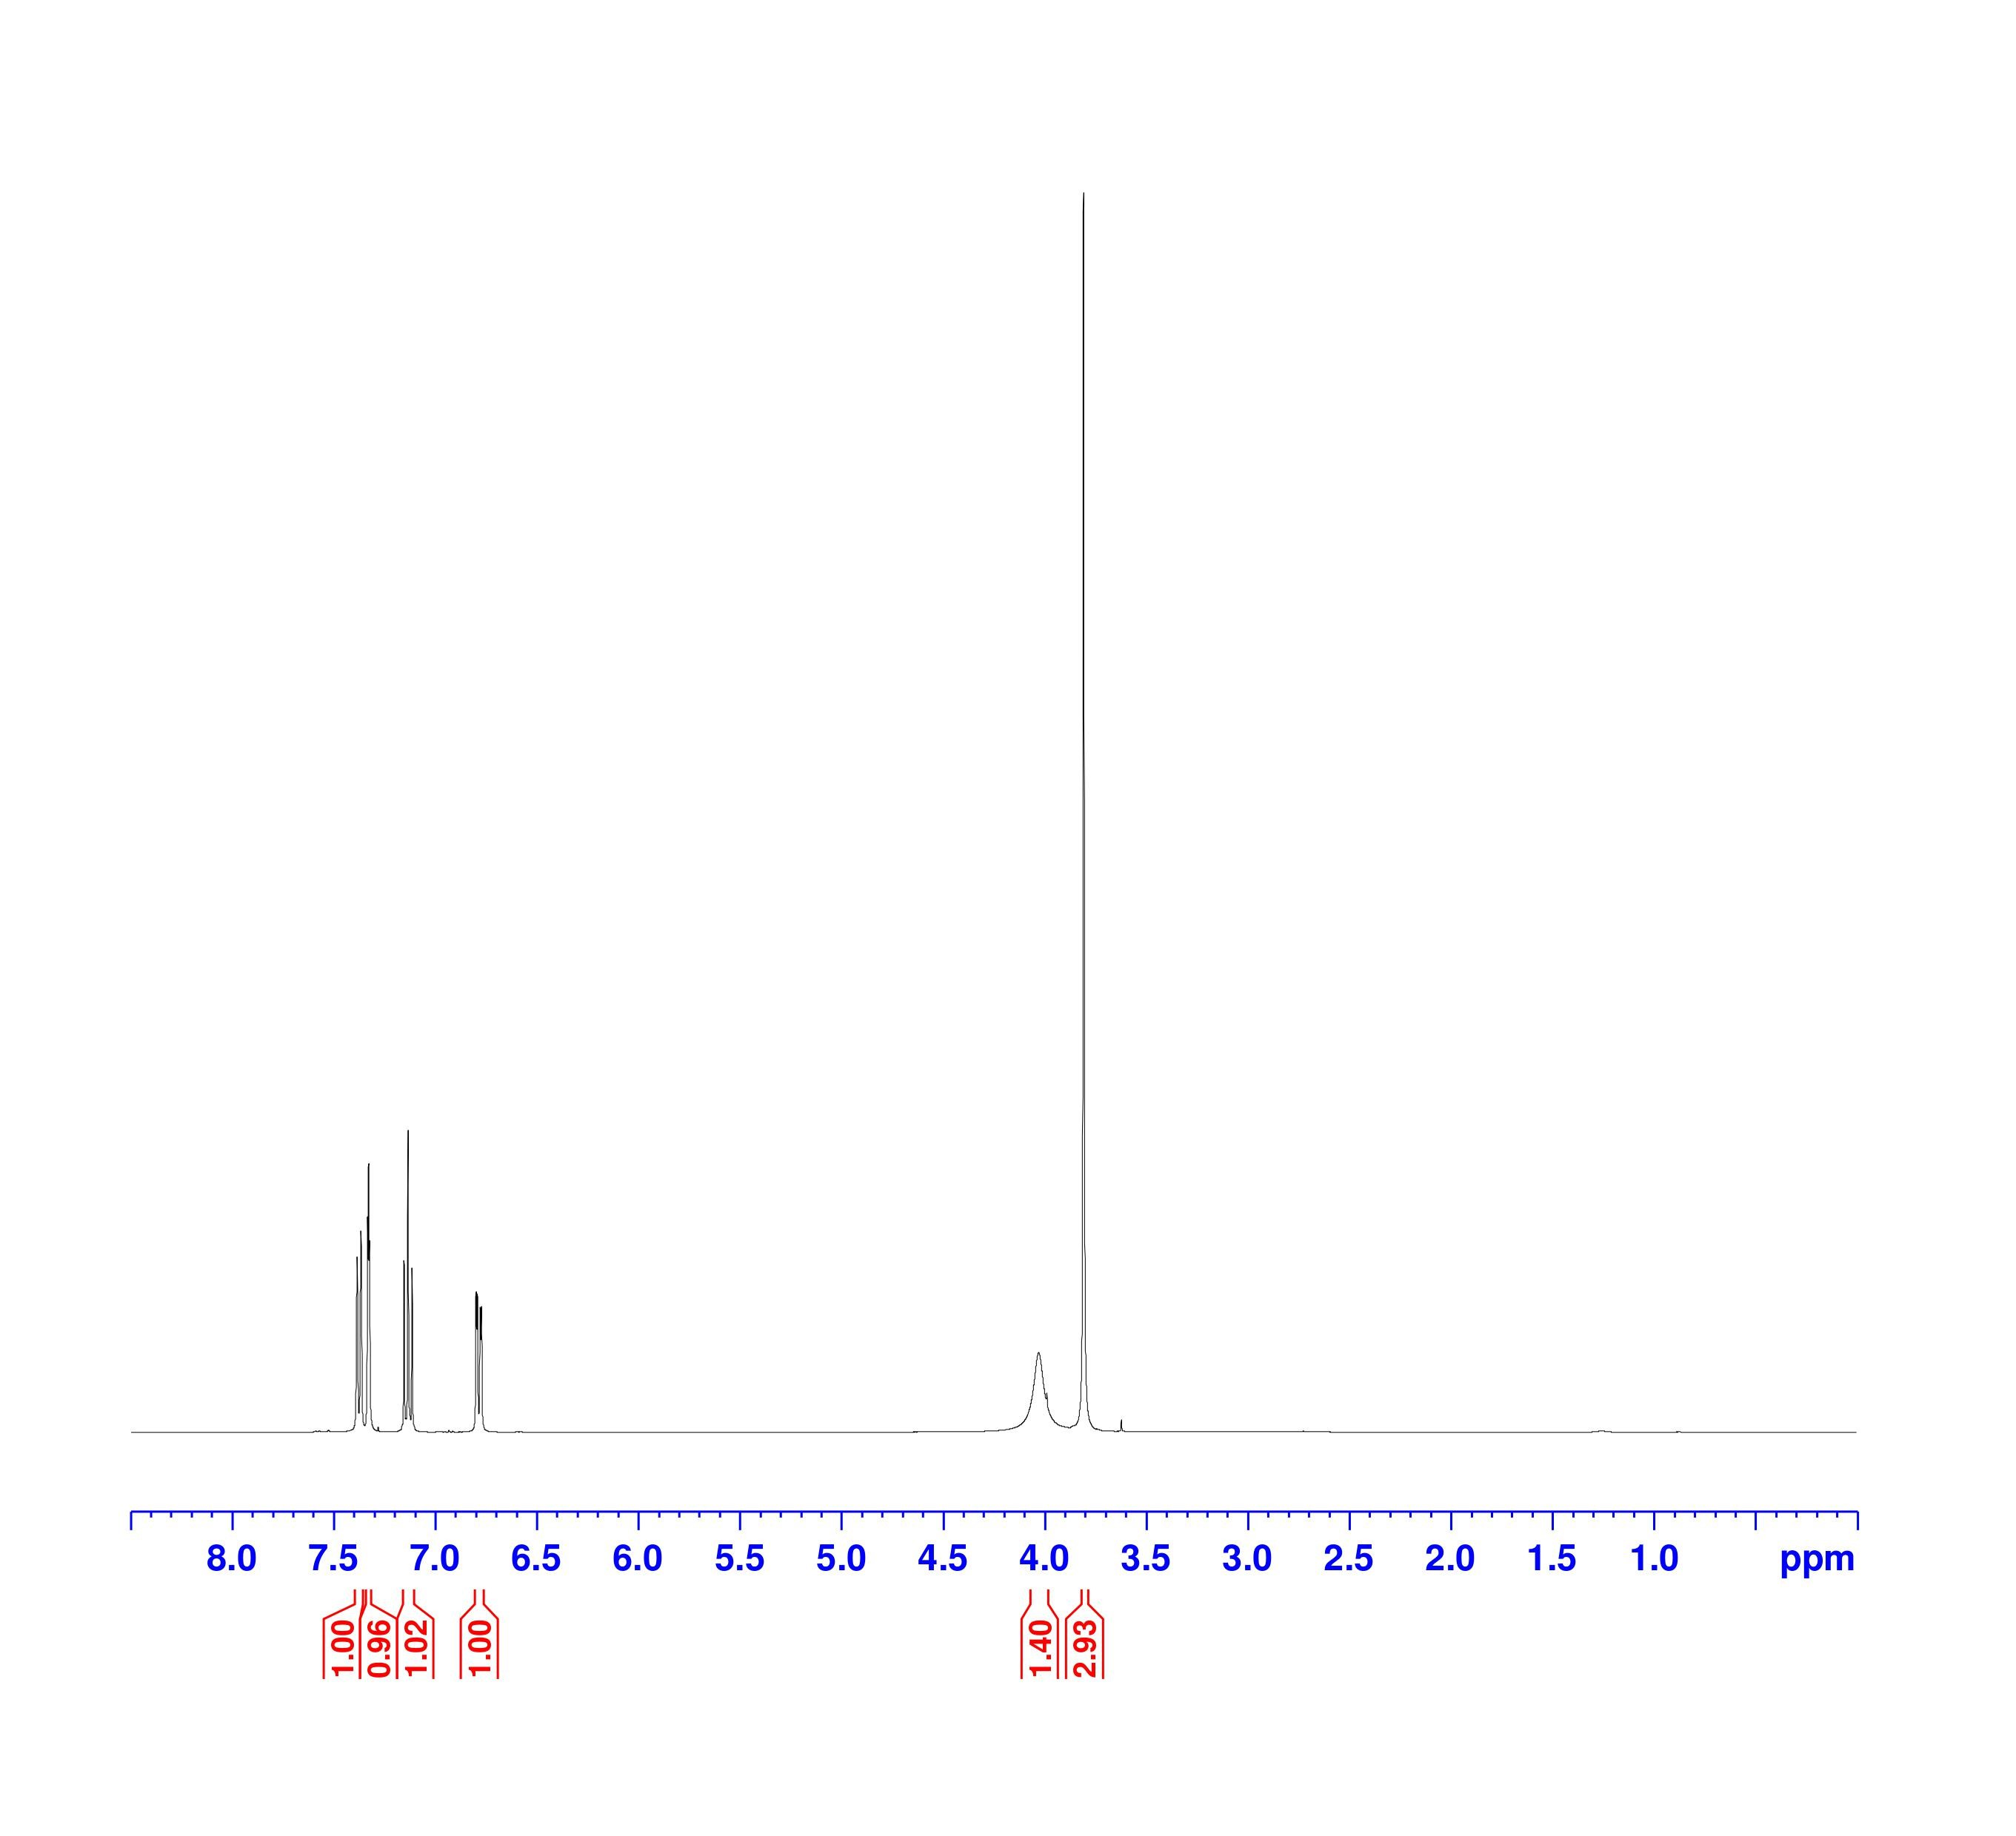
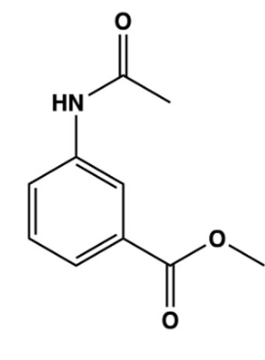
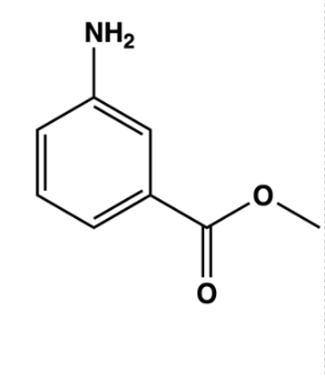
Light-Activated Surgical Glue
Light-Activated Surgical Glue
Oscar Allen¹, Eunice Lim², Pengfei Wang²
¹Department of Physics and Astronomy, Middle Tennessee State University, ²Department of Chemistry, University of Alabama at Birmingham
Motivation
Many surgical glues exist and are used in hospitals already, but none are activated with light, and all are specific use case. We are attempting to create a new glue that is light-activated which will allow for pinpoint precision and control over the location and timing of the glue activation. A light-activated surgical glue would have many applications, such as for eye surgery, post heart surgery, and medical device installment. Repairing the eye using the commonly used modern medicine techniques is quite difficult because of the fragility of the eye. If we were able to create a biocompatible and biodegradable glue, then performing surgery on the eye will become easier to repair. Another application of our glue is to attach a device to an organ to administer a drug on precise intervals, but with things like stapes and sutures, we can’t quite do that.
My contribution
Scheme 2. Full glue synthesis
Photo 1. Doing TLC and Column
Background information
My lab discovered new chemical reactions that allow for the formation of strong chemical bonds (C-N bonds). Our glue works on the premise of breaking bonds (C-O bonds) with UV light inside of our compound. Once the bonds are broken, they are left open and able to bond with external surfaces making it “sticky”. Scheme 1 shows us the process of breaking the C-O bonds with the use of newly discovered chemical reactions using UV light and then the formation of C-N bonds.
The glue starts by combining 3-aminobenzoic acid,
Sulfuric acid [H₂SO₄], and Methanol [MeOH] to
create the second product.
After the second product is created, I combined it with Triethylamine [Et₃N] and Acetyl Chloride [CH₃COCl] to create the third product.
Scheme 3. First reaction
Scheme 4. Second reaction
Scheme 1. Photochemical C–N Bond Formation
Photo 2. Swapping samples
Photochemical Formation and Cleavage of C–N Bond
Pengfei Wang, Wenya Lu, Dattatray Devalankar, and Zhenying Ding
Organic Letters 2015 17 (1), 170-172
DOI: 10.1021/ol503473c
TLC 1.
TLC 2.
TLC 3.
NMR 1. Wash after first synthesis.
NMR 2. Wash after second synthesis
CH₃
An NMR shows the purity of products.
CH₃ #2
CH₃ #1
B
A
B
A
CH₃ #2
Conclusions and future work
-As of right now (7/21/23) we are planning on testing the tensile and shearing stresses the glue can withstand to see its usefulness in surgical applications.
C
D
CH₃
C
D
CH₃ #1
A
C
D
B
A
B
C
Acknowledgments
Support provided by National Science Foundation (Grant # DMR-2148897 – Research Experiences for Undergraduates (REU) awarded to UAB
D
Photo 3. Collecting NMR data

