Slide 1
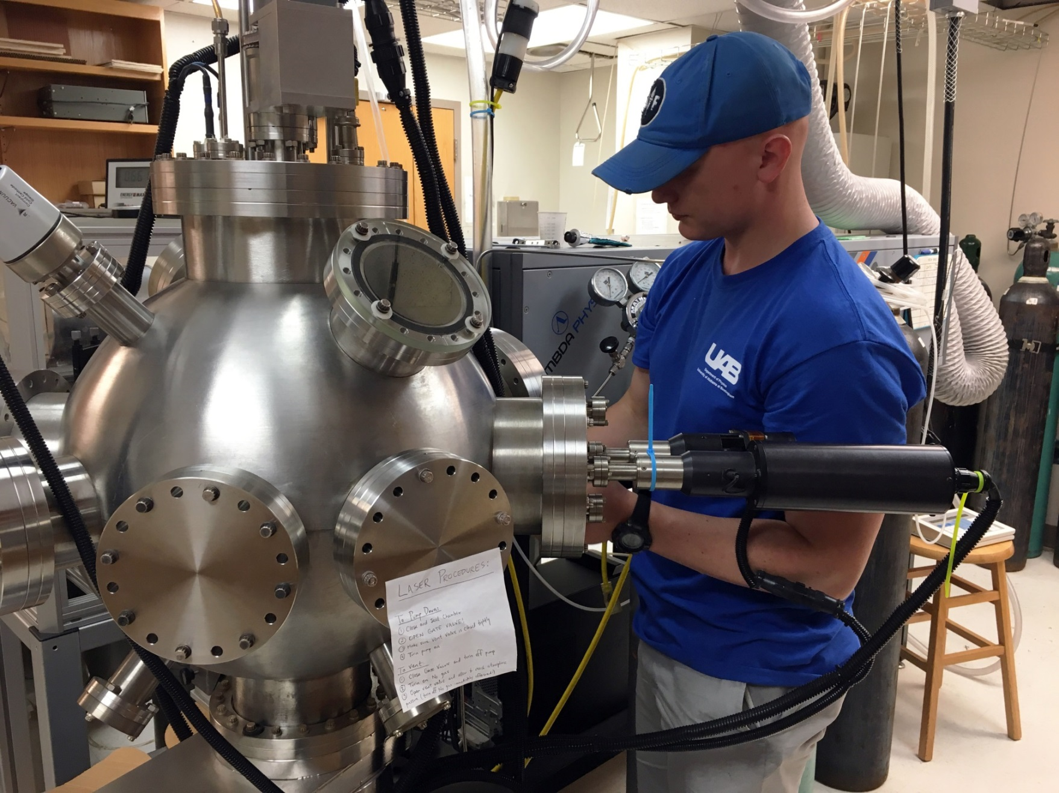
Kaleb Burrage, University of North Georgia Faculty Mentor, Dr. Renato Camata

Slide 2
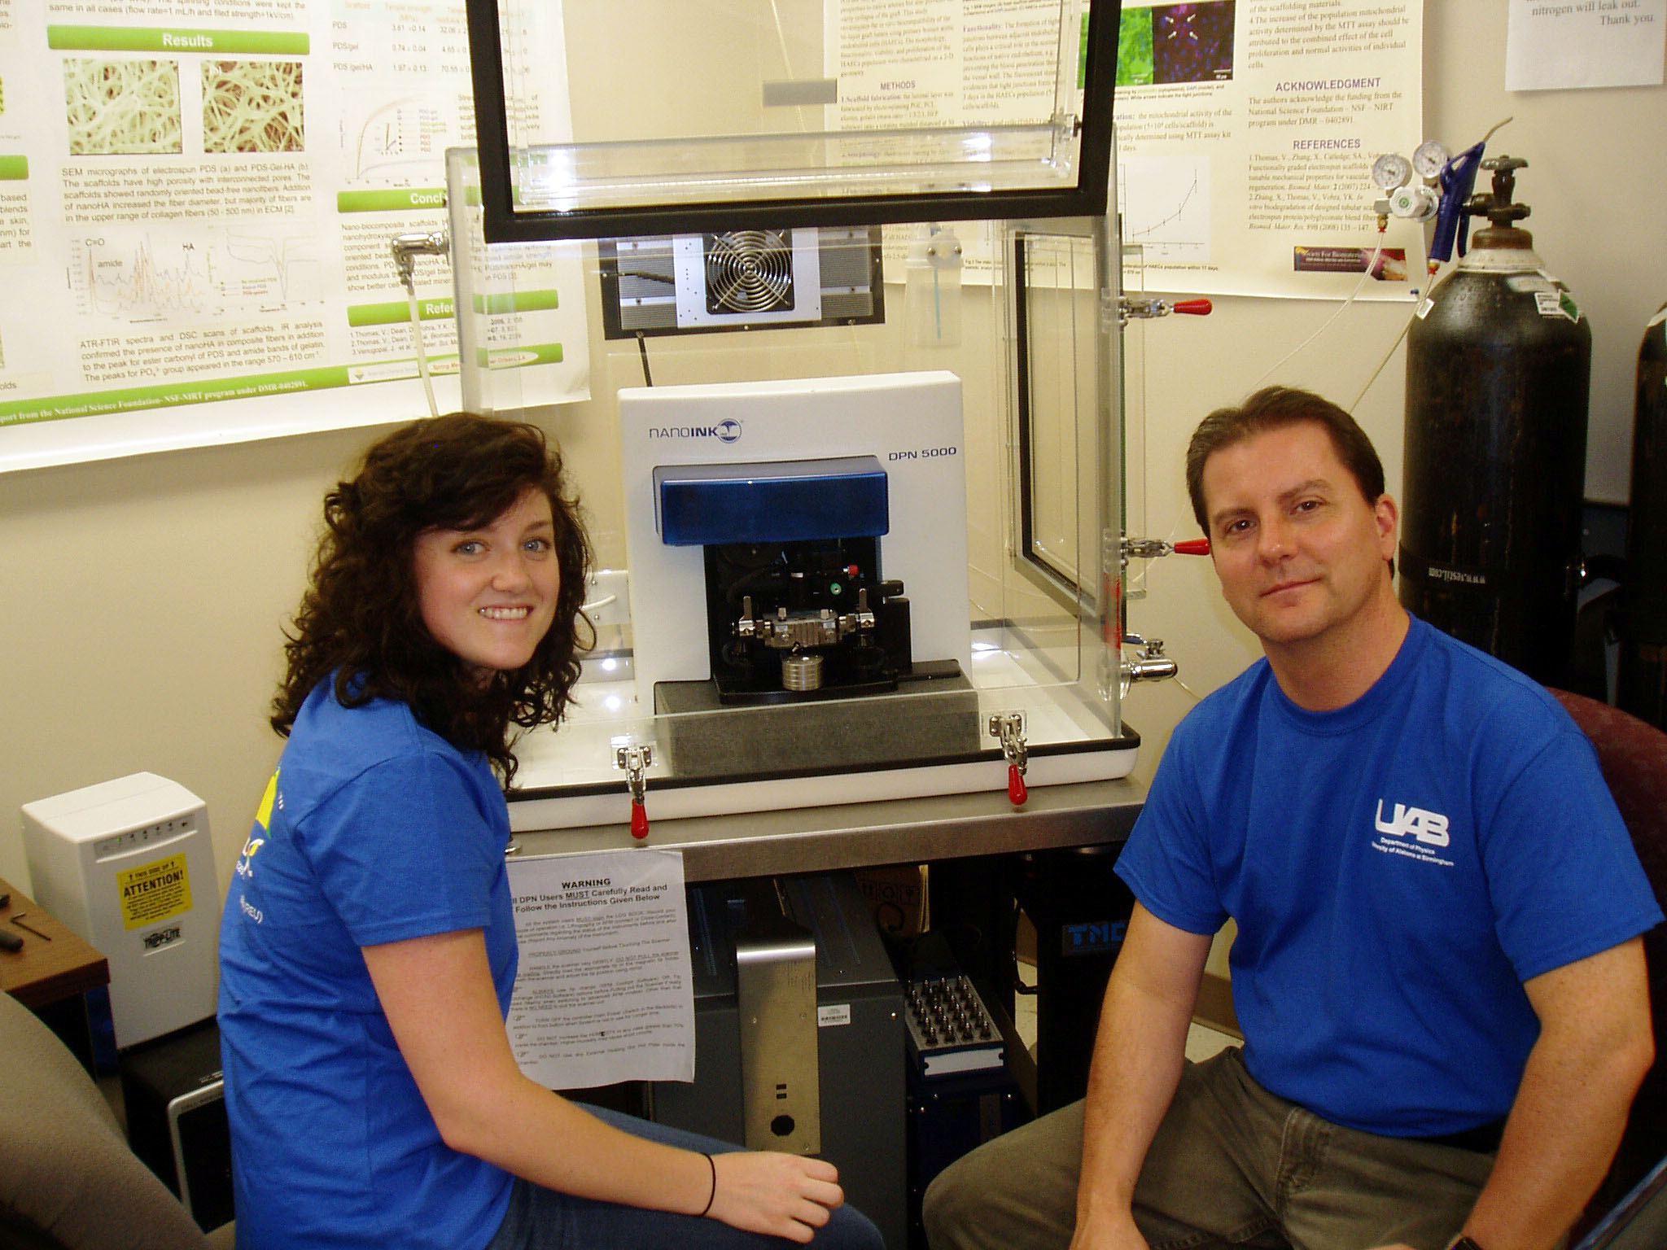
REU Kate Davis, University of Montevallo Faculty Mentor Dr. Shane Aaron Catledge

Slide 3
REU Julian Dover, Chicago State University & Mentor Benjamin Willis, Engineer

Slide 4
REU Aidan Farr, The University of the South & Faculty Mentor Dr. Robert Mohr

Slide 5
REU Evan Garrison, University of Alabama at Birmingham & Mentor Dr. Ryoichi Kawai

Slide 6
REU David Goodloe, Birmingham Southern College Postdoc Mentor, Dr. Paul Baker

Slide 7
REU David Goodloe (r),
Birmingham Southern College
Postdoc Mentor Dr. Paul Baker Postdoc

Slide 8
REU Craig Johnson, St. Augustine’s University & Faculty Mentor & REU Program Director Dr. Yogesh K. Vohra

Slide 9
REU Matthew Stiles (r), Utah Valley University Faculty Mentor Dr. David Hilton (c), Postdoc Mentor Dr. Biplob Barman (l)

Slide 10
Left (REU Victor Torres (c) Colorado College Postdoc Mentor, Mohamed Selim (l) Mentor Benjamin Willis, Engineer (r)

Slide 11
REU Rick Watkins, UAB Faculty Mentor Dr. Vladimir Fedorov

Slide 12
REU Brianna Kenney, Alabama A & M University & Mentor Dr. Jami Dashdorj, Research Associate

Slide 13
REU Ashli Moore, Oakwood University (l) Faculty Mentor Dr. LuFang Zhou (r)

Slide 14
REU Jacob Norman, UC Berkeley & Faculty Mentor Dr. Eugene Kharlampieva

