Slide 1
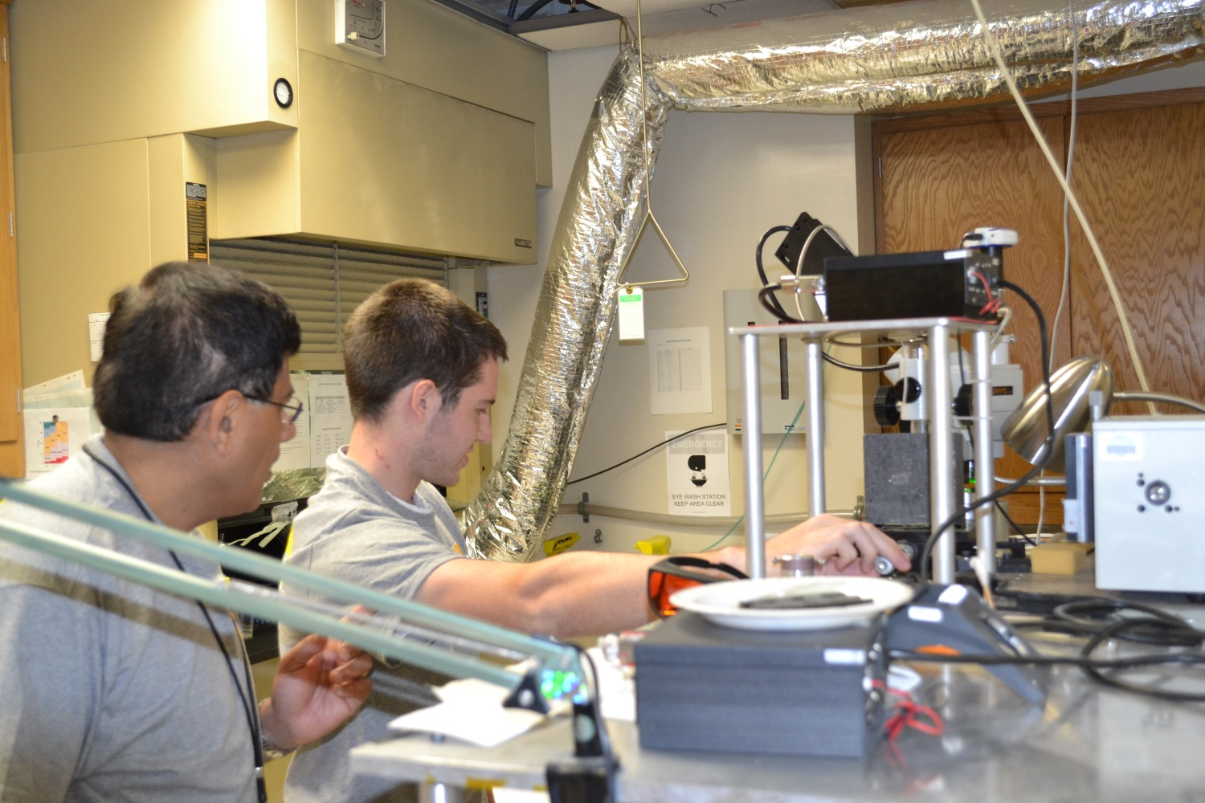
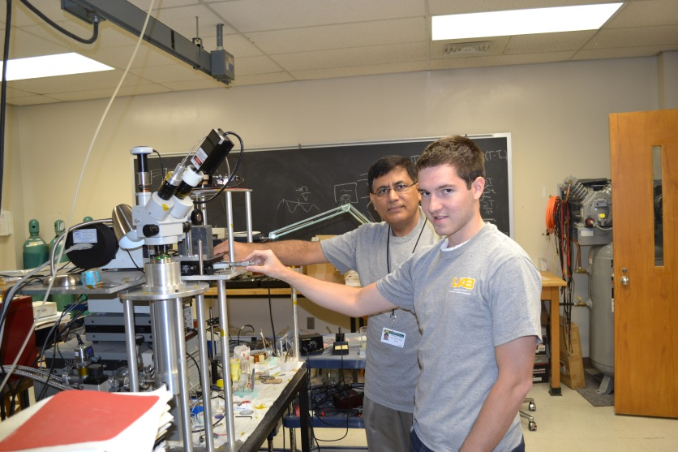
REU Daniel Cargill, Hendrix College Dr. Yogesh K. Vohra, Mentor

Slide 2
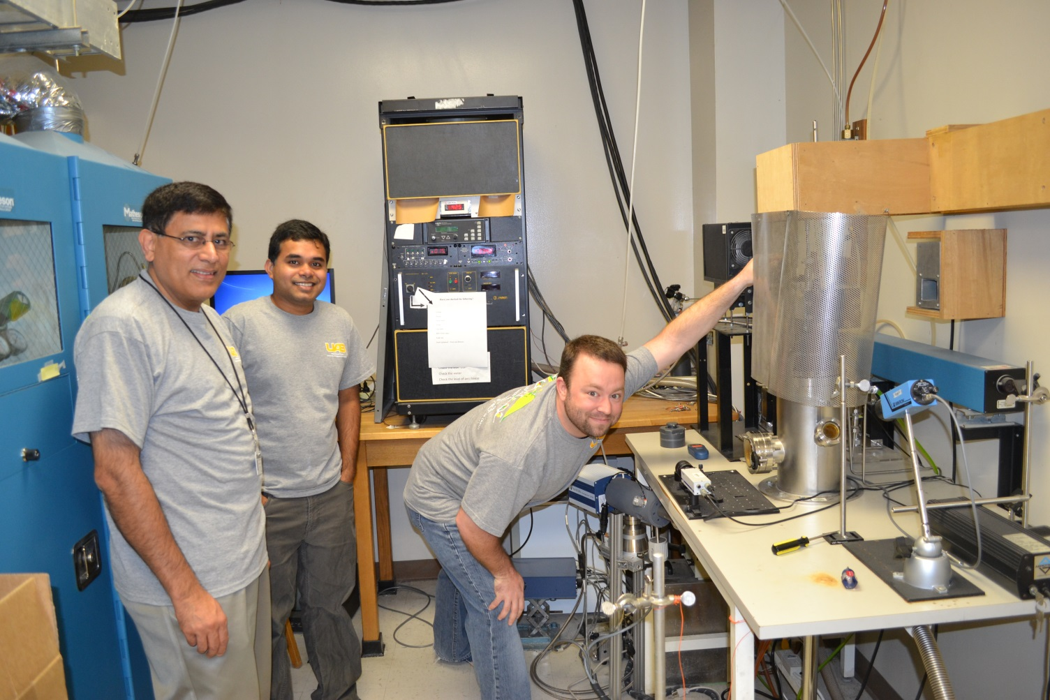
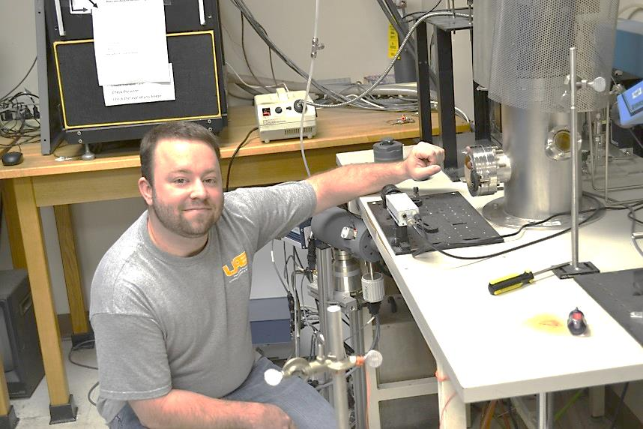
REU Robert Reeves (r), University of Tennessee Martin Dr. Yogesh K. Vohra, Mentor (l) Gopi Samudrala, Postdoc Mentor (c)

Slide 3
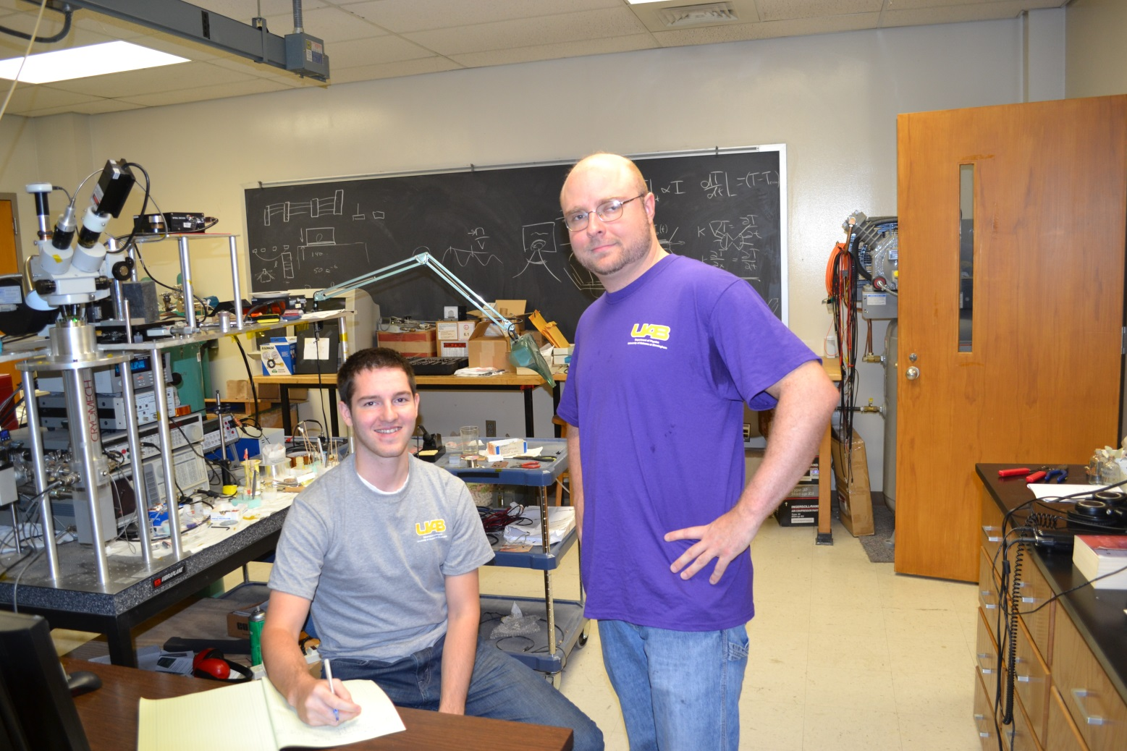
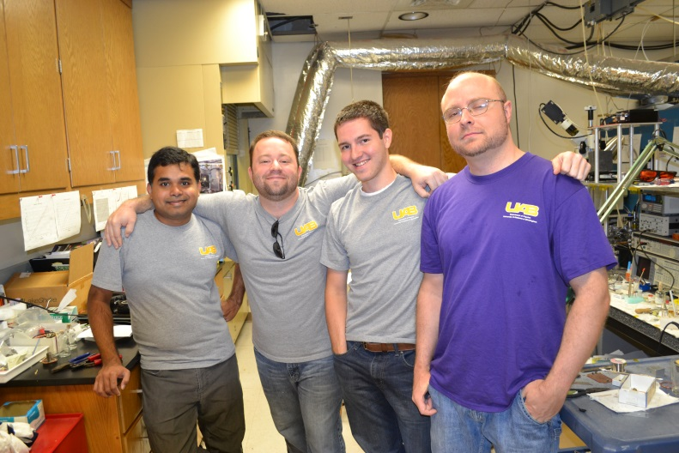
REU Daniel Cargill, Hendrix College Jeff Montgomery, Grad Student Mentor
Dr. Vohra’s Group: Gopi Samudrala, REU Robert Reeves, REU Daniel Cargill & Grad Student Jeff Montgomery

Slide 4
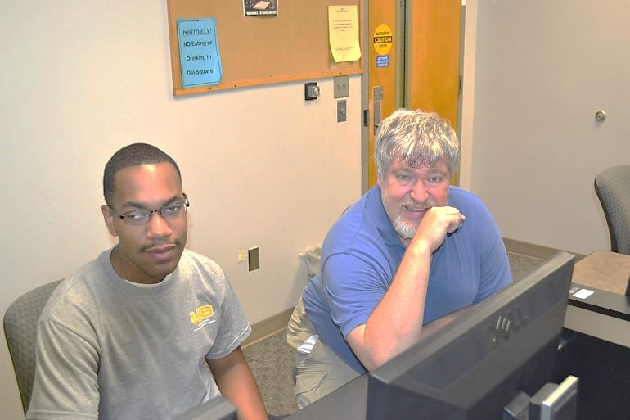
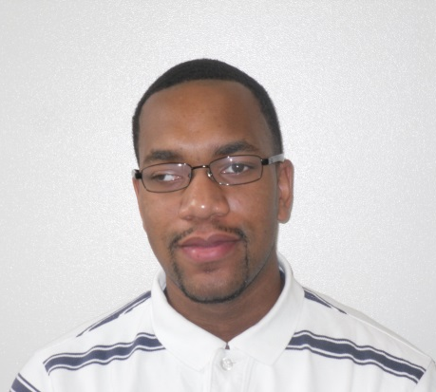
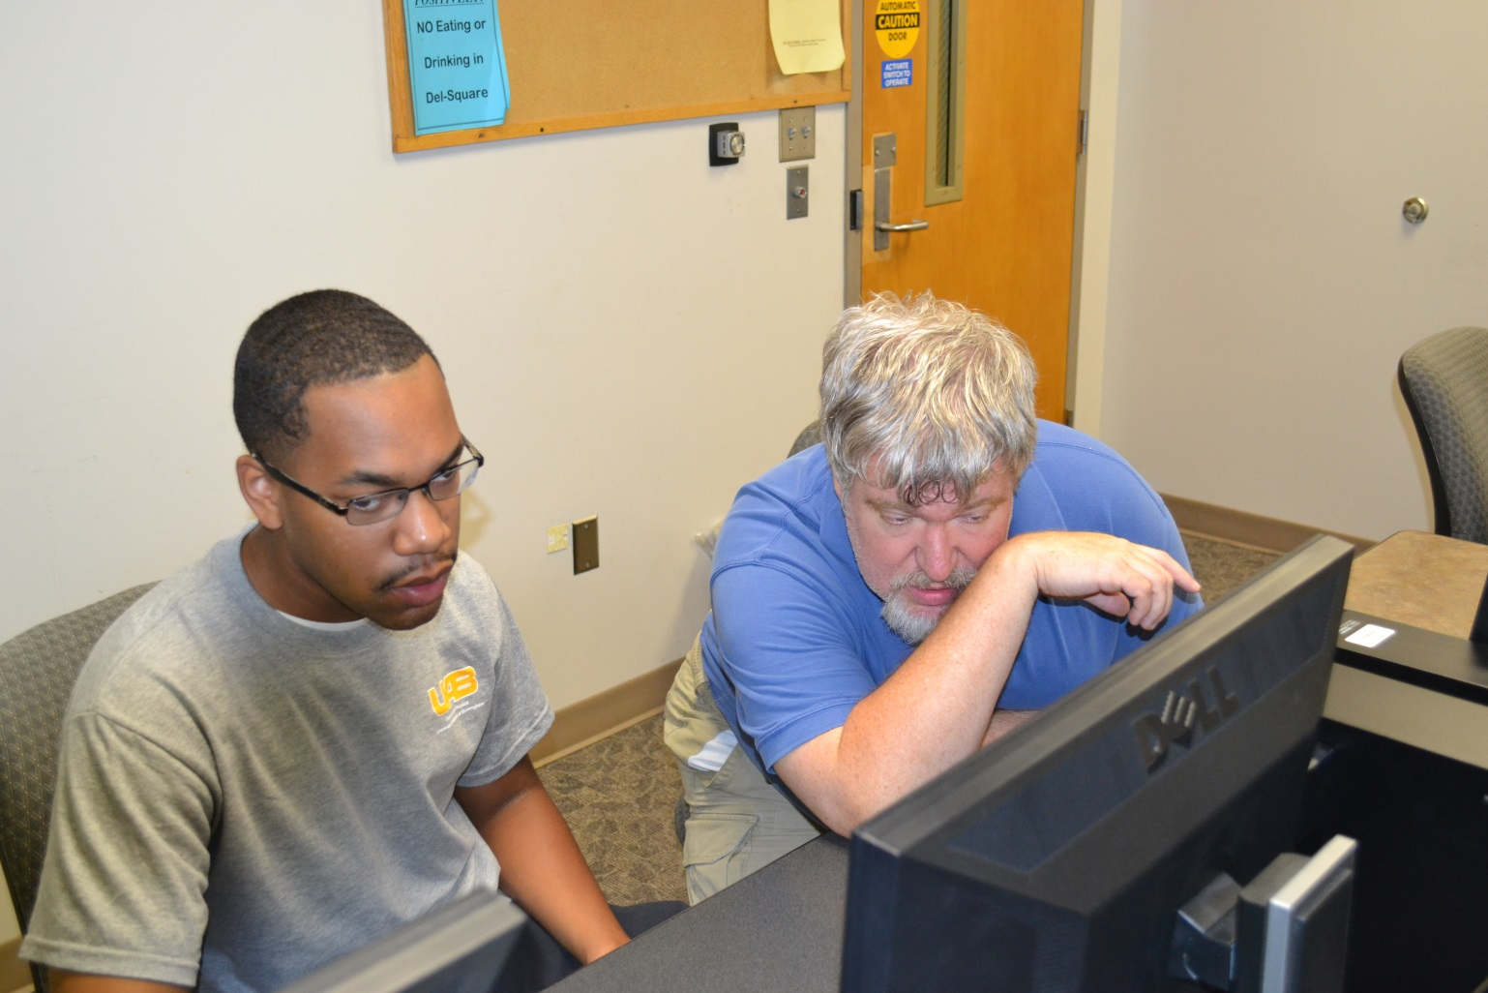
REU Terence Staples, UAB Dr. Robert Mohr, Mentor

Slide 5
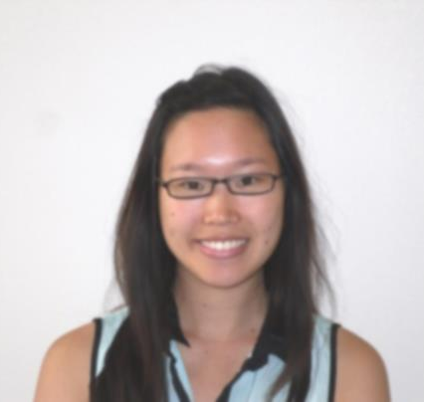
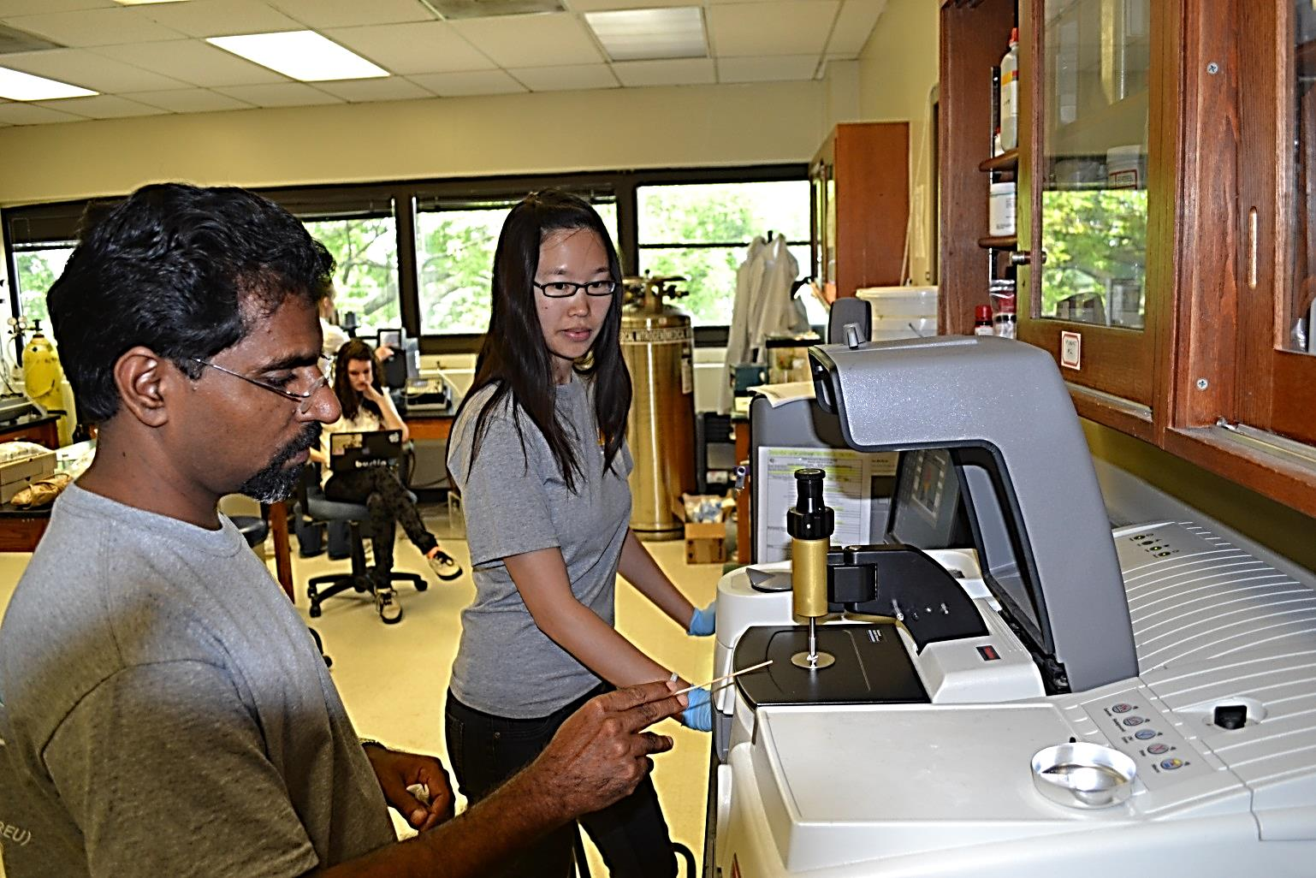
REU Hillary Lam, Johns Hopkins University Dr. Vinoy Thomas, Mentor

Slide 6
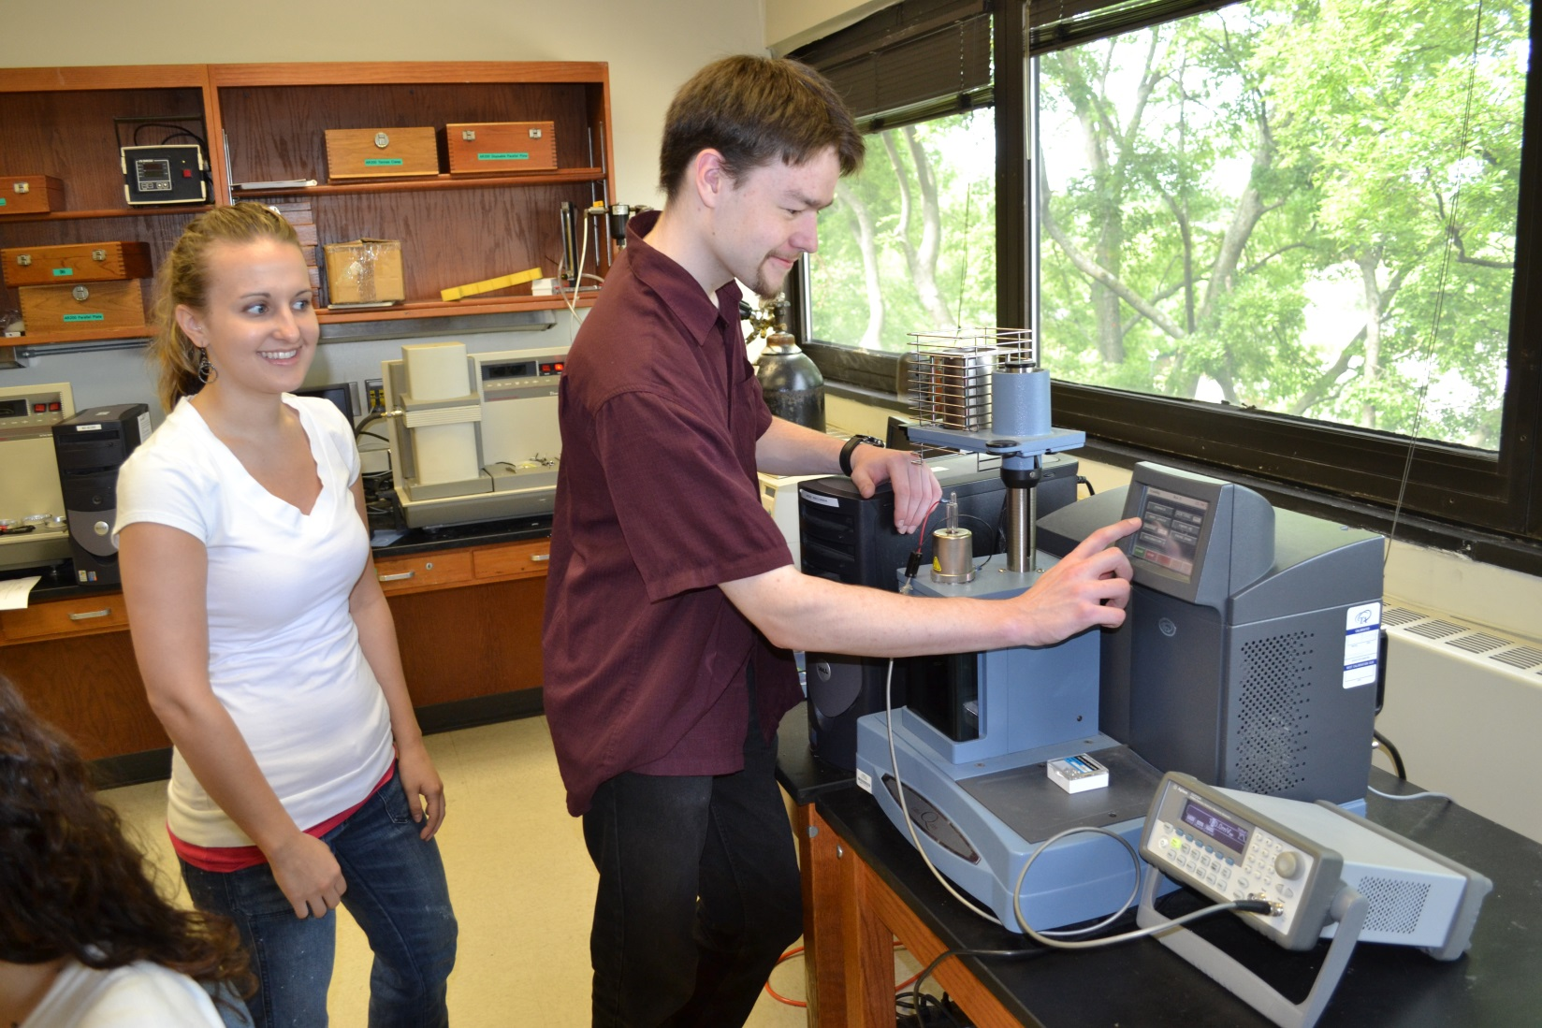
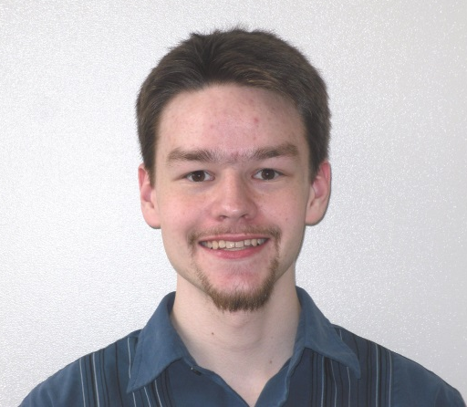
REU Matthew Bailey, University of Maryland Baltimore County Carrie Schindler, Grad Student Mentor Dr. Derrick Dean, Faculty Mentor (not shown)

Slide 7
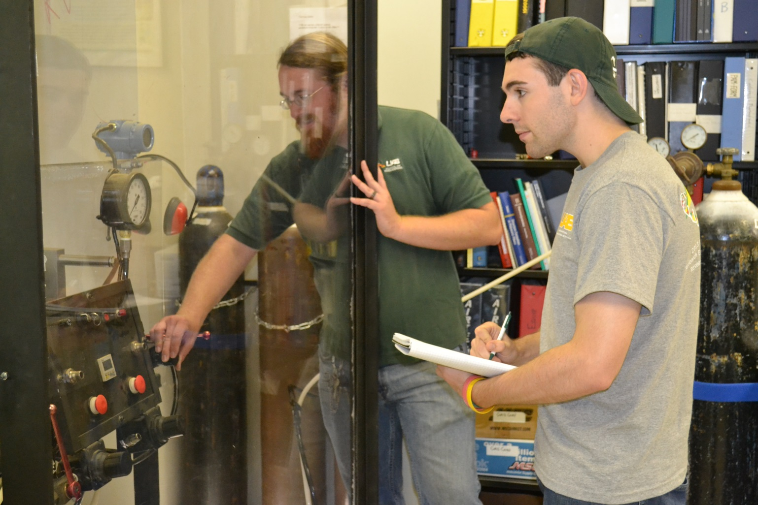
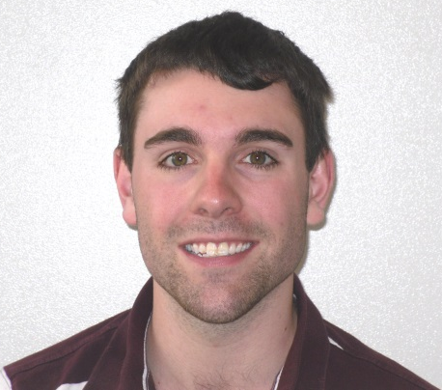
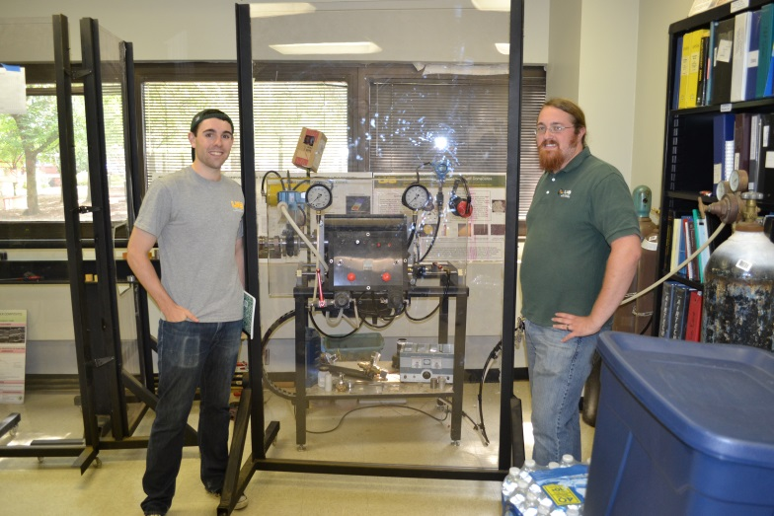
REU Matthew Record (top-r), Bates College Grad Student Mentor, Benjamin Geiger-Willis Dr. Uday Vaidya, Faculty Mentor (not shown)

Slide 8
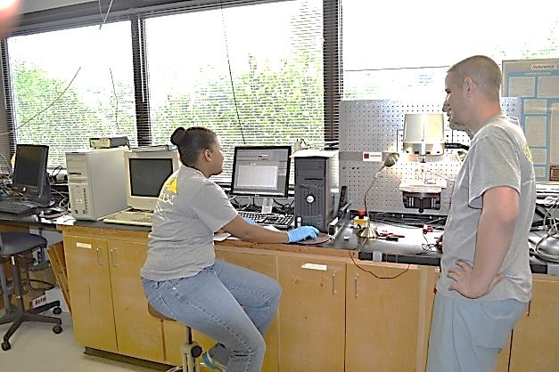
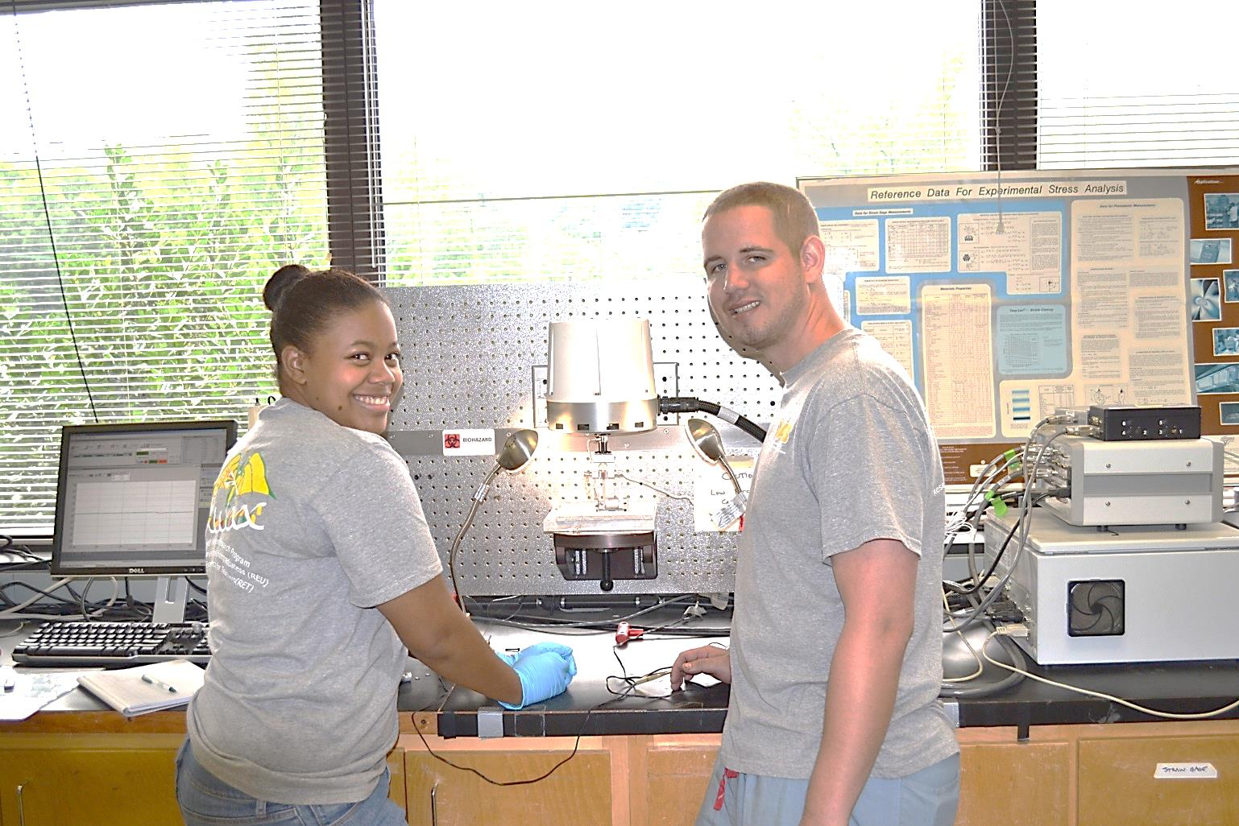
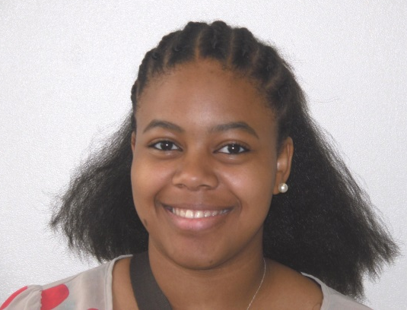
Jamika Polk, Jackson State University Joseph Shwertz, Grad Student Mentor Dr. Alan Eberhardt, Faculty Mentor (not shown)

Slide 9
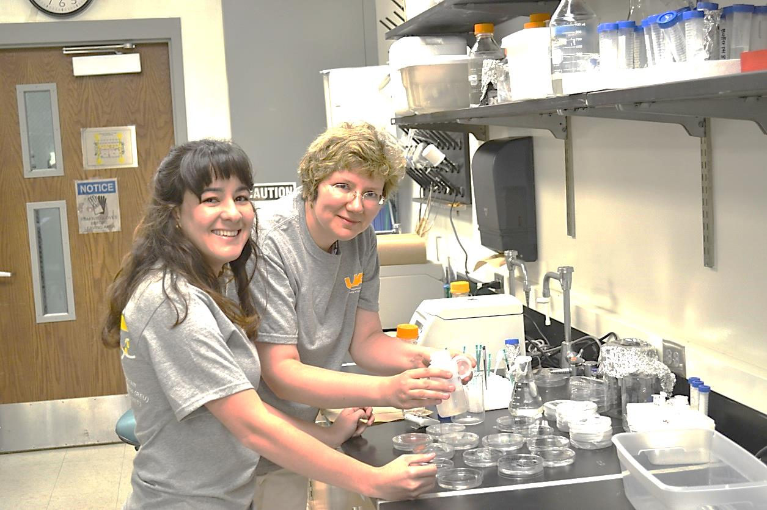
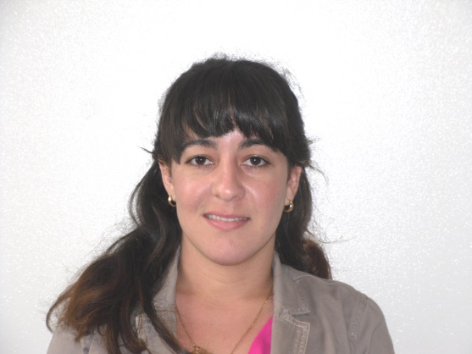
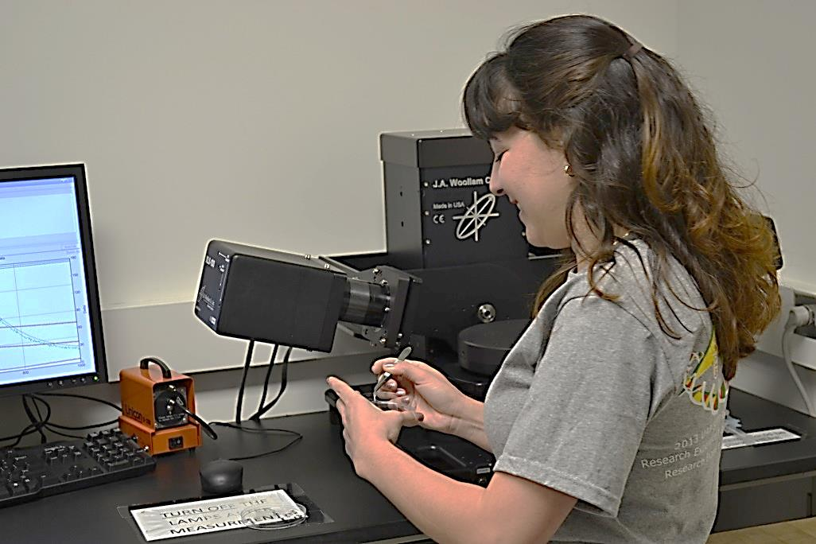
REU Claudia Lopez, Florida Int’l University Dr. Eugenia Kharlampieva, Mentor

Slide 10
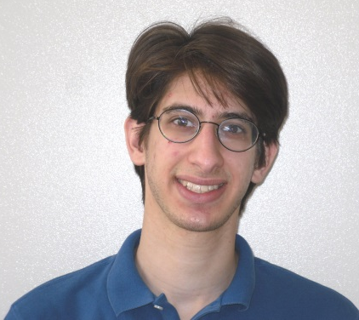
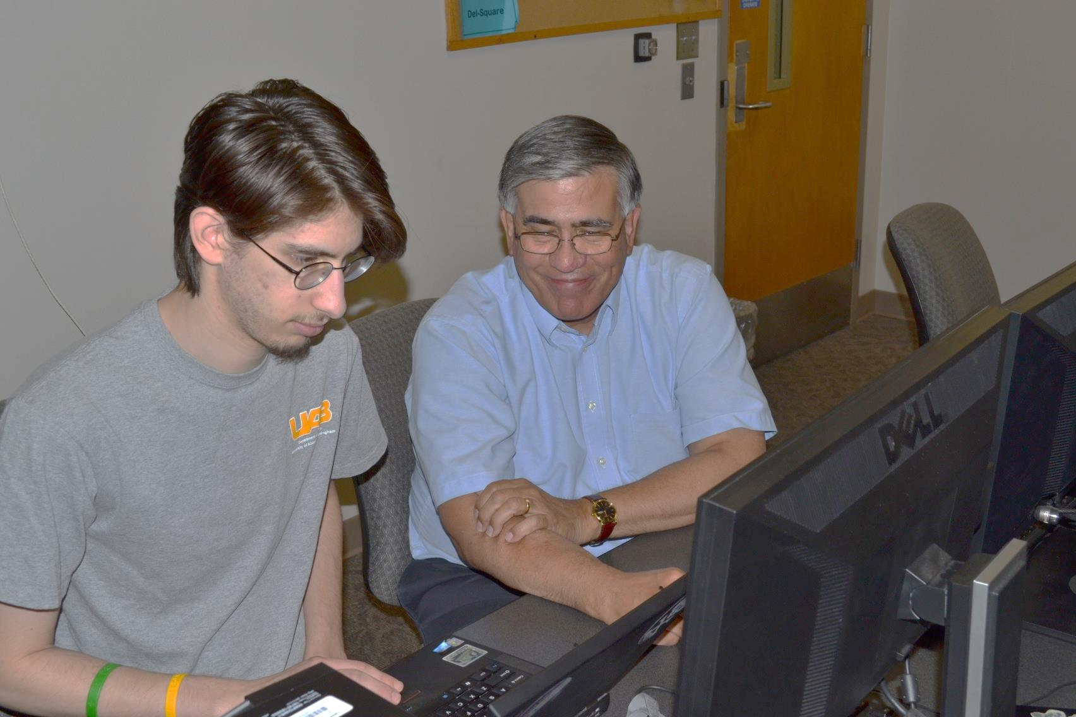
REU Joshua Plottel, Polytechnic Institute Dr. Joseph Harrison, Mentor

Slide 11
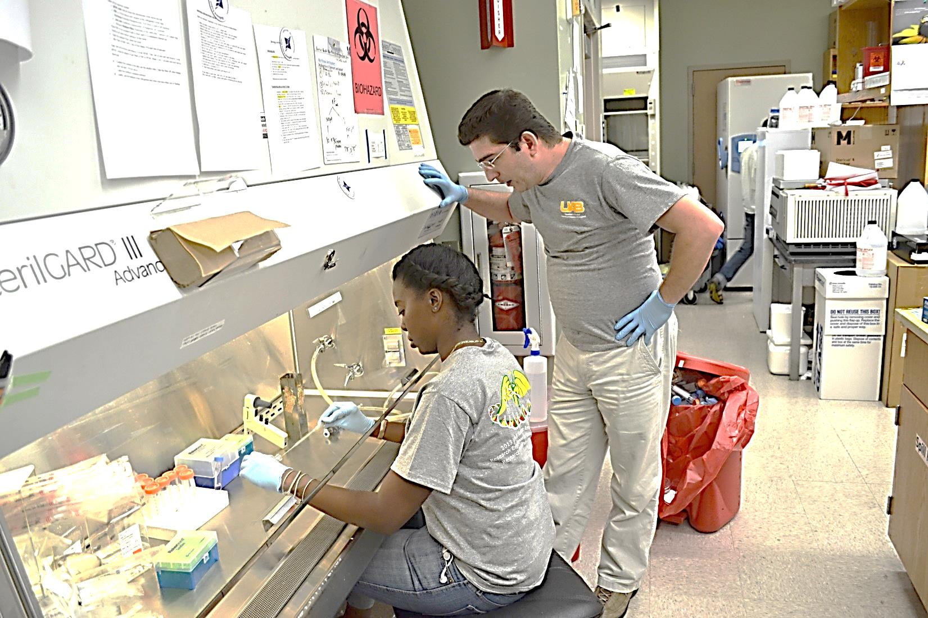
REU Danielle Taylor, Norfolk State University Yasin Oduk, Grad Student Mentor Dr. Veena Antony, Faculty Mentor (not shown)

Slide 12
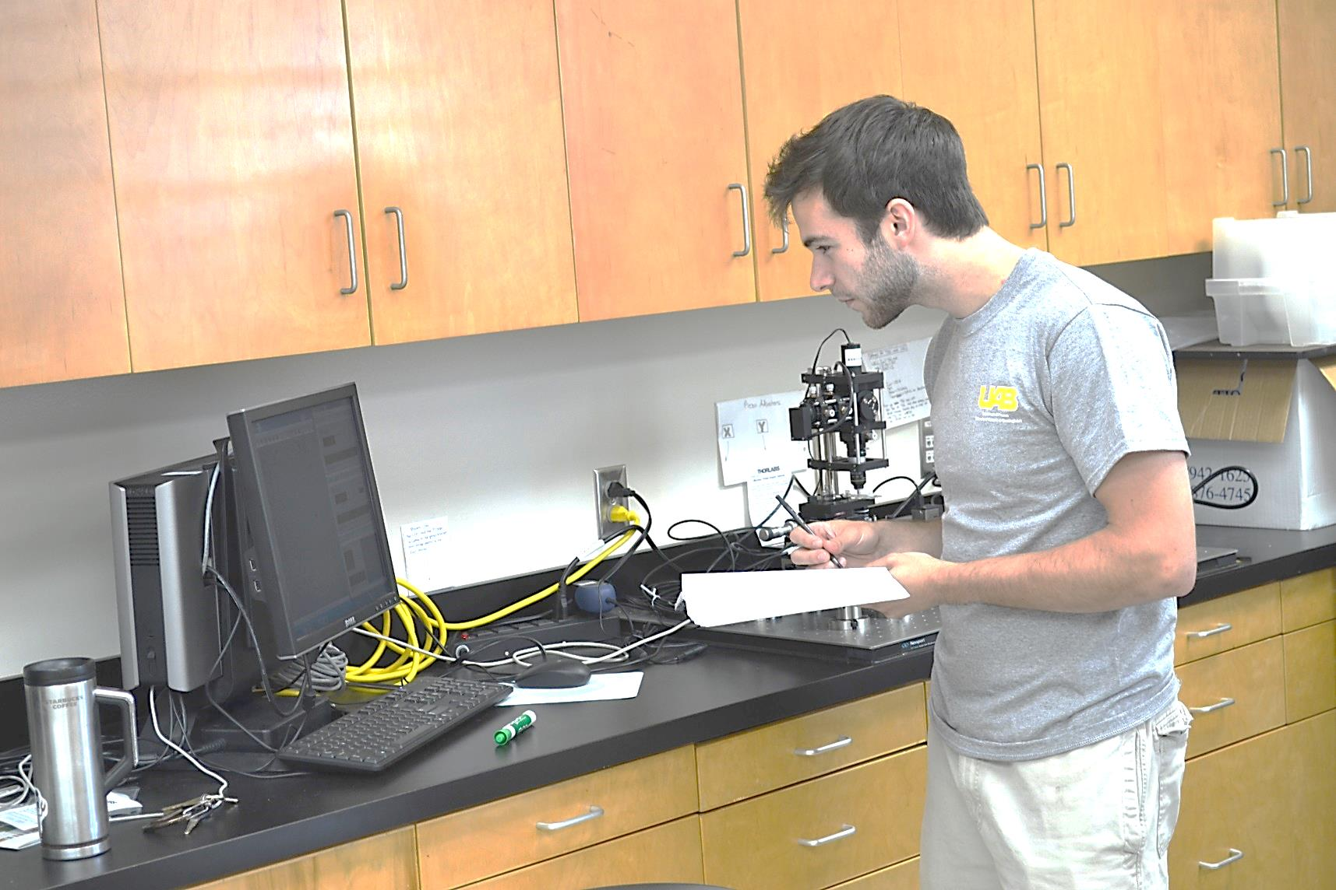
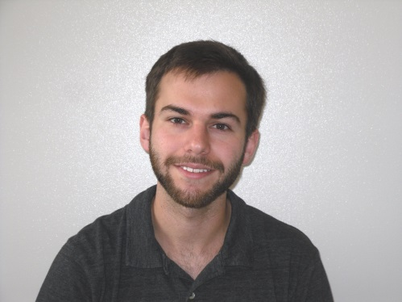
REU Phillip “Hunter” Allman, UAB Dr. Renato Camata, Faculty Mentor

Slide 13
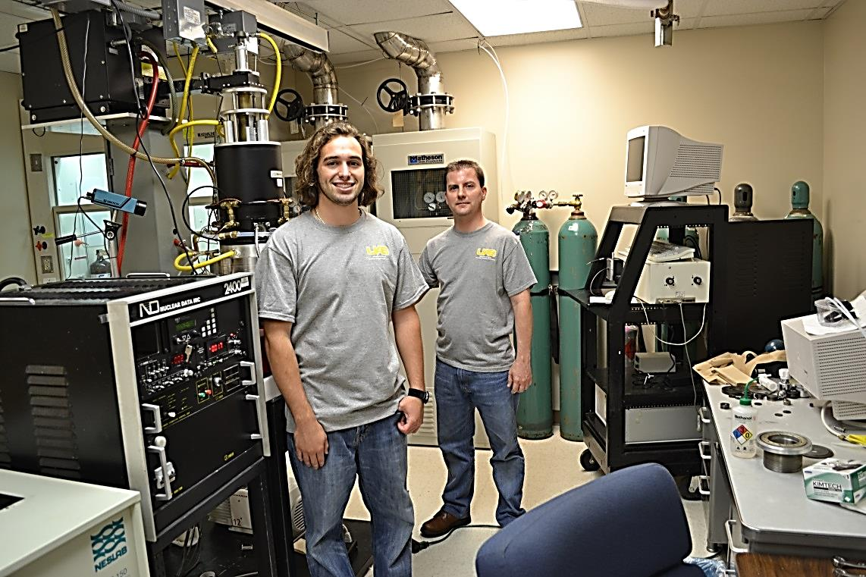
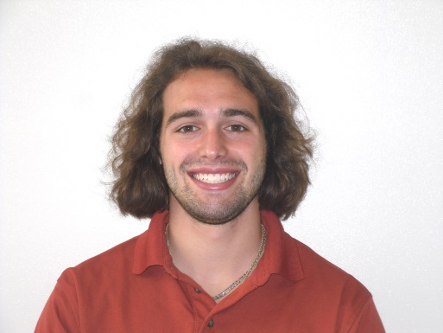
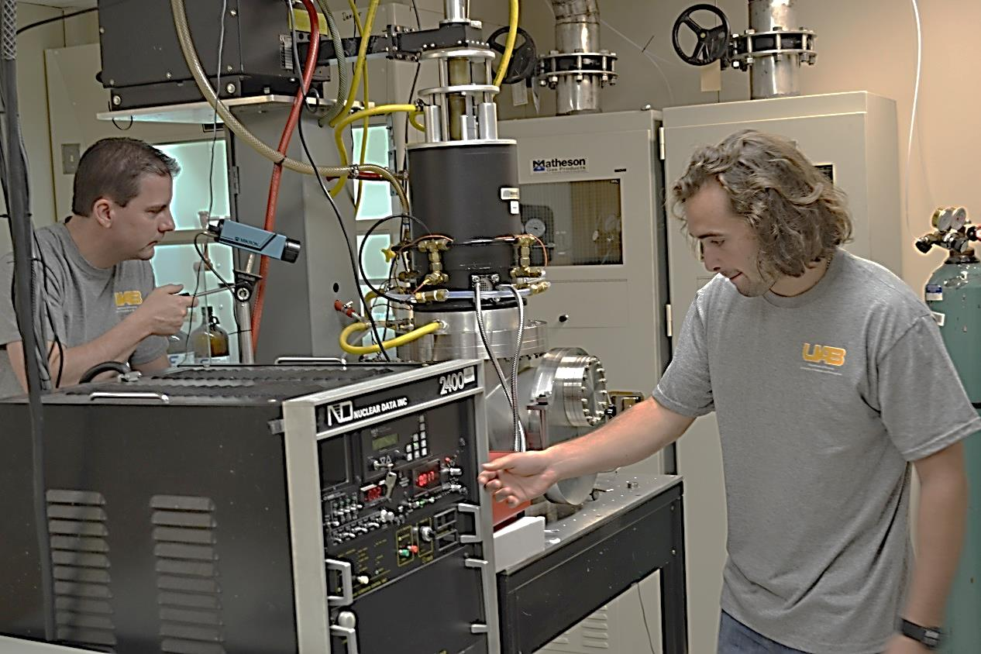
REU Jacob Quattrini, St. John Fisher College Dr. Aaron Catledge, Mentor

Slide 14
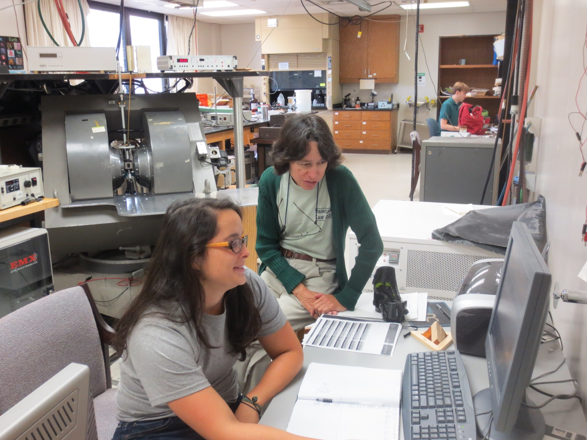
REU Constance Previti, Clemson University Dr. Mary Ellen Zvanut, Mentor

Slide 15
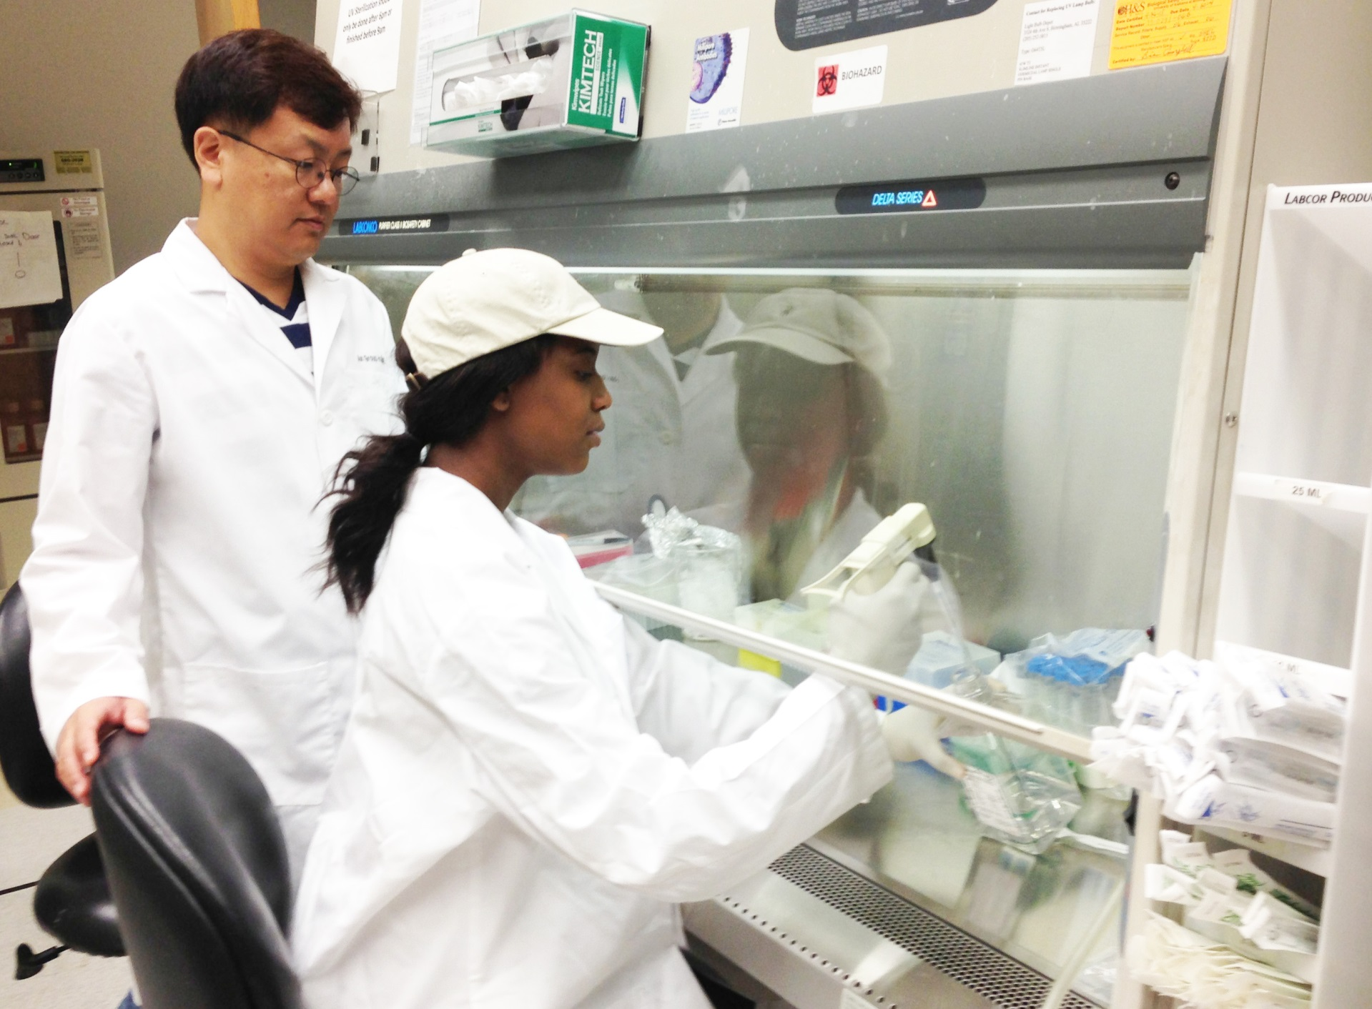
REU Taneidra Walker Dr. Ho-Wook Jun, Mentor

